Slide 1
LHC
Large Hadron Collider
http://en.wikipedia.org/wiki/CERN
Richard Lasky – Summer 2010

Slide 2
Large Hadron Collider
The Large Hadron Collider (LHC) is a gigantic scientific instrument near Geneva, where it spans the border between Switzerland and France about 100 m underground
Two beams of subatomic particles called 'hadrons' – either protons or lead ions – will travel in opposite directions inside the circular accelerator, gaining energy with every lap

Slide 3
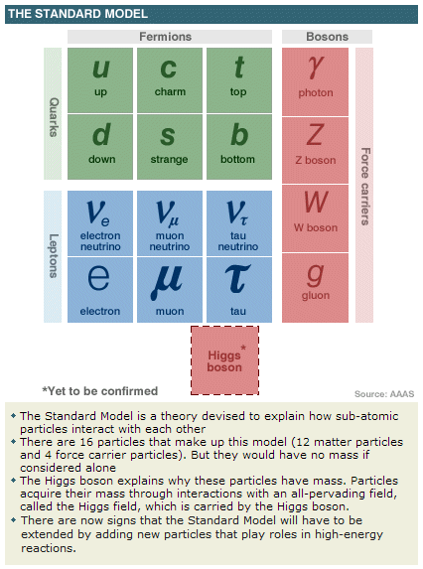

Slide 4
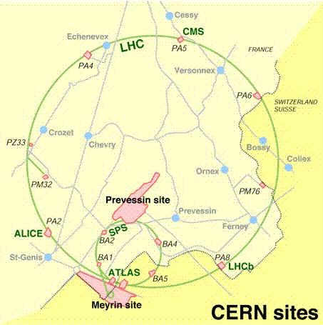
CERN map

Slide 5
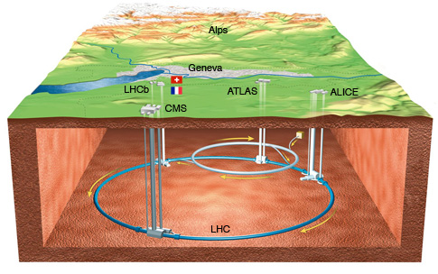
CERN below ground

Slide 6
Acceleration of particles
http://www.youtube.com/watch?v=qQNpucos9wc

Slide 7
LHC experiments
Six experiments at the LHC are all run by international collaborations
The two large experiments, ATLAS and CMS, are based on general-purpose detectors to analyze the myriad of particles produced by the collisions in the accelerator
Two medium-size experiments, ALICE and LHCb, have specialized detectors for analyzing the LHC collisions in relation to specific phenomena
Two experiments, TOTEM and LHCf, are much smaller in size. They are designed to focus on ‘forward particles’ (protons or heavy ions)

Slide 8
Atlas Collision events
http://www.youtube.com/theATLASExperiment

Slide 9
Function of Detector components
 | Positon | Energy | Energy | Energy
 | Tracking | Electromagnetic | Hadronic | Muon chambers
 | chamber | calorimeter | calorimeter
electron & positrons | YES | YES | - | -
photons | - | YES | - | -
pions | YES | YES | - | -
neutrons | - | - | YES | -
muons neutrinos | YES | YES | YES | YES

Slide 10
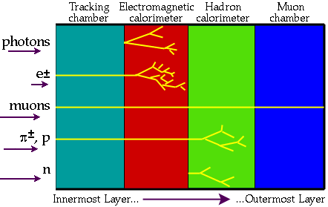
Interaction of various particles with the different components of a detector

Slide 11
How does a tracking detector work?
Very simply - the curvature of the path can be measured and from that the momentum can be determined. Here is how it works:
The track is circular is circular so the force required to keep the particle moving on a circular path is given by
F = mv² / r
The force experienced by a particle in an electric field is given by
F = qvB

Slide 12
How does a tracking detector work?
The field CAUSES the circular path, the EFFECT; so here it means that
qvB = mv² / r
which simplified is mv = qBr = p
Or the Momentum, P = qBr
q = coulomb constant = 1.6 X 10ˉ¹⁹
B = magnetic field
r = radius of curvature

Slide 13
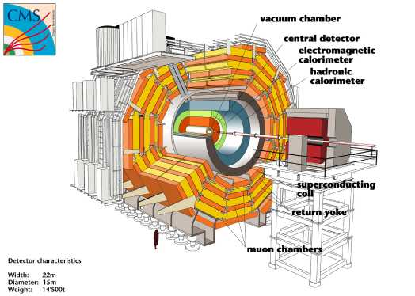
CMS(Compact Muon Solenoid) detector
http://www.youtube.com/CMSExperimentTV#p/a/f/1/2jup2R9Jtnc

Slide 14
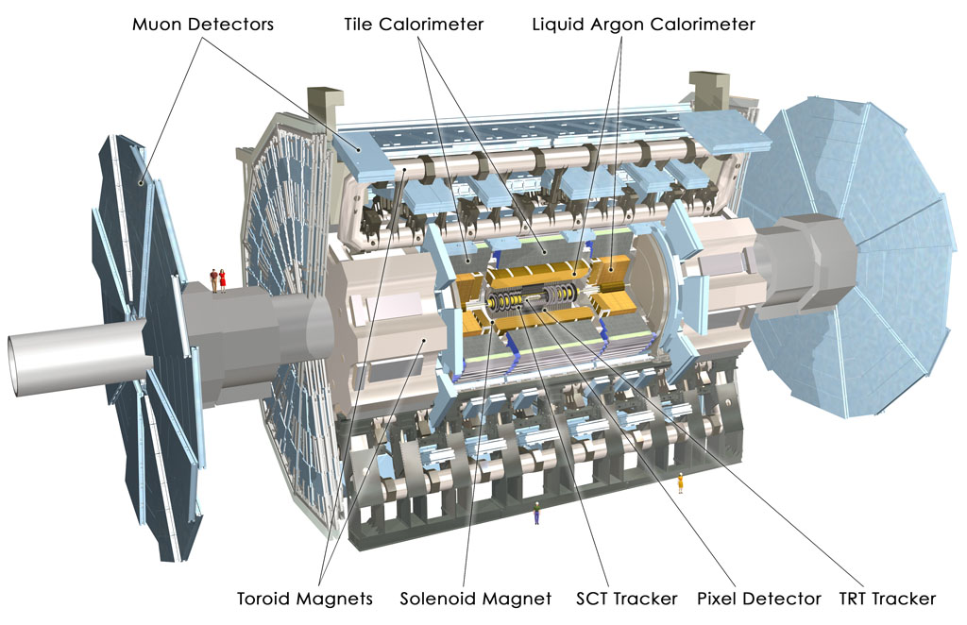
Atlas Detector
http://atlas.ch/detector.html

Slide 15
Detection of particles
http://www.youtube.com/watch?v=Kf3T4ZHnuvc&feature=related

Slide 16
CERN overview
http://www.youtube.com/watch?v=rgLdIly2Xtw&feature=related

Slide 17
LHC rap
http://www.youtube.com/watch?v=j50ZssEojtM

