Slide 1
Cosmic Ray e-Lab
Overview

Slide 2
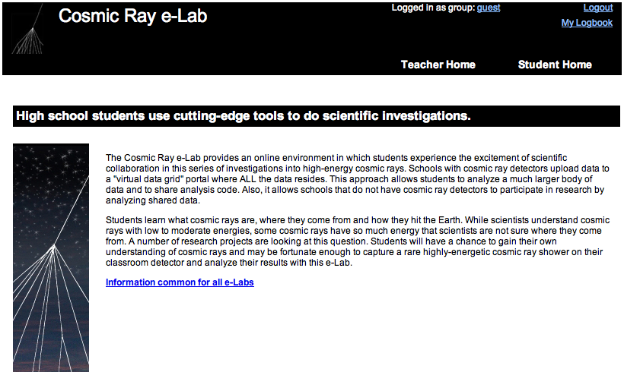
Teaching and Learning
with the Cosmic Ray e-Lab
http://www.i2u2.org/elab/cosmic

Slide 3
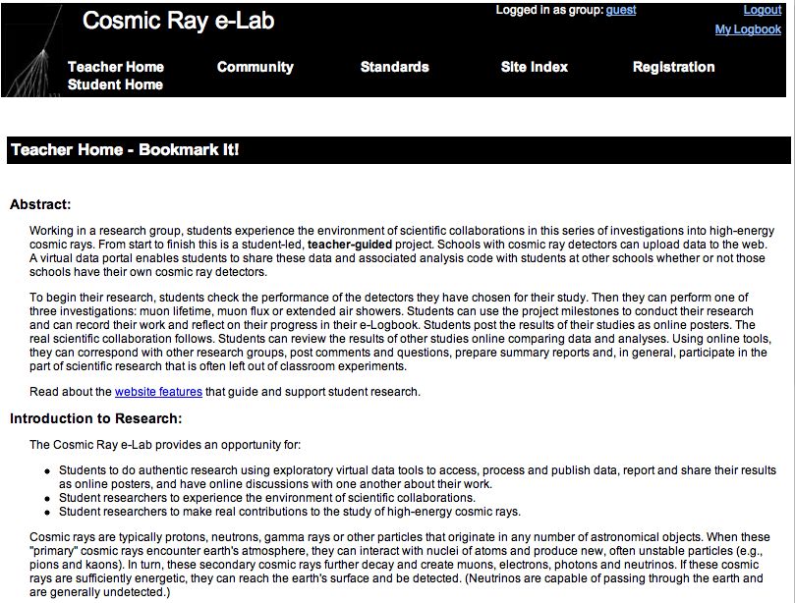
Teaching and Learning
with the Cosmic Ray e-Lab
Notes:
ALL PREVIOUS: STUDENT
ALSO TEACHER SIDE

Slide 4
Teaching and Learning
with the Cosmic Ray e-Lab
Cosmic Ray e-Lab --> Assessment
The e-Lab provides:
Rubrics.
e-Logbooks.
Milestone seminars.

Slide 5
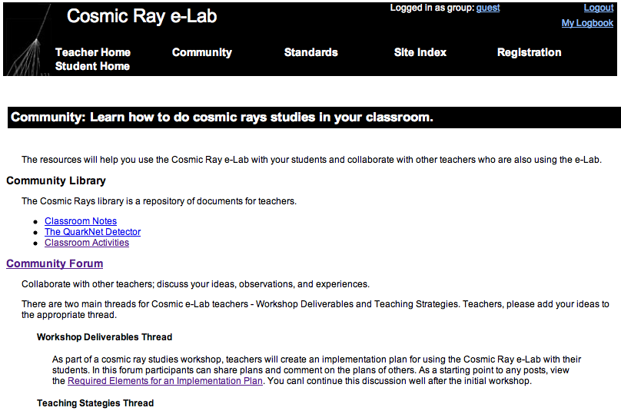
Teaching and Learning
with the Cosmic Ray e-Lab
Notes:
ALL PREVIOUS: STUDENT
ALSO TEACHER SIDE

Slide 6
Teaching and Learning
with the Cosmic Ray e-Lab
Go to: REGISTRATION
1st: Change password.
--> Update your previously created groups.
!! min 6 characters : max 10 characters !!
!! alpha/numeric !!
!! no spaces !!
2nd: Create student group.
--> Register student research groups.
Select “pencil”: yes pre/post test
3rd: Add DAQ #.
--> Update detector IDs for your group.
Notes:
Change password: 6 character PW

Slide 7
Teaching and Learning
with Cosmic Rays
Debrief:
Summarize in LogBook

Slide 8
Teaching and Learning
with the Cosmic Ray e-Lab
Notes:
These screen grabs are static.
May prefer to do this “tour” live action.
The “look/feel” of the pages may change with time.

Slide 9
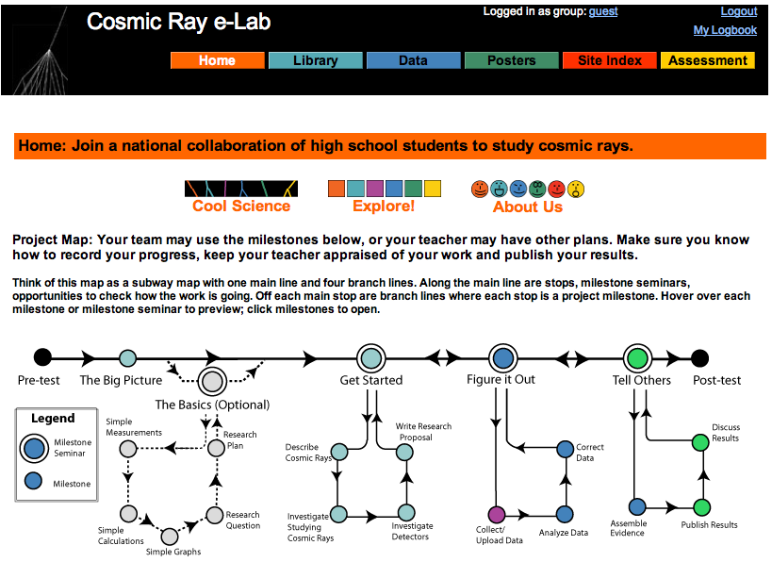
Teaching and Learning
with the Cosmic Ray e-Lab

Slide 10
Teaching and Learning
with the Cosmic Ray e-Lab
Quick Links

Slide 11
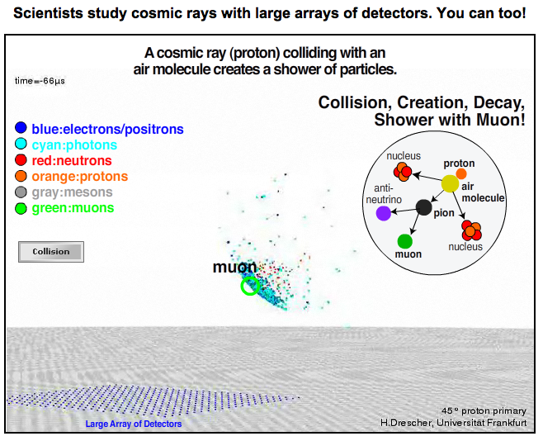
Teaching and Learning
with the Cosmic Ray e-Lab
Notes:
Make sure audio is connected for workshop.
Point out large array - scale is off with classroom detector.

Slide 12
Teaching and Learning
with the Cosmic Ray e-Lab
Students can tour the site.
Notes:
Good place for students to roam and explore the site before diving in to a full-blown investigation.

Slide 13
Teaching and Learning
with the Cosmic Ray e-Lab
Project Map
Notes:
Each hot spot has a rollover with short explanation. Click to open milestone.
Legend defines milestones and seminar.

Slide 14
Teaching and Learning
with the Cosmic Ray e-Lab

Slide 15
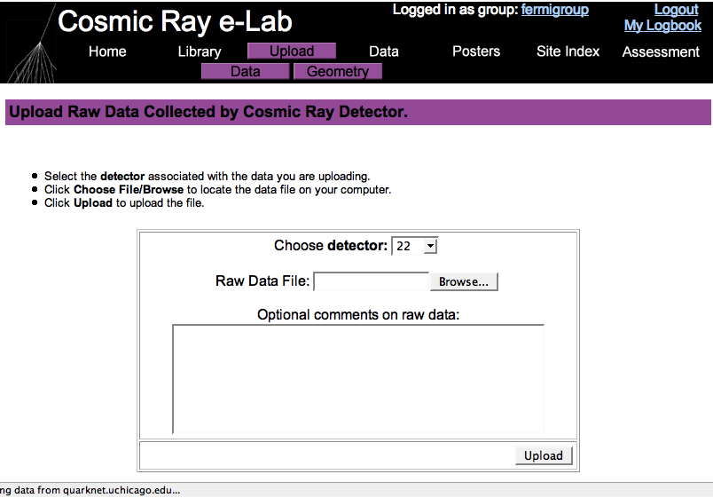
Teaching and Learning
with the Cosmic Ray e-Lab

Slide 16
Teaching and Learning
with the Cosmic Ray e-Lab
Pause: Live action demo
--> UPLOAD data: Follow me.
--> GEOMETRY: Review tutorial.
Notes:
Use CRMD data from previous night data-take.
Recruit owner with data to drive.
Project data computer so others can watch.
Login to their account.
Select proper DAQ#; Browse for data; add pithy comment; upload.
Ask Mentor for advice on pithy comments.
Input GEOMETRY; may wait for later, but don’t forget.

Slide 17
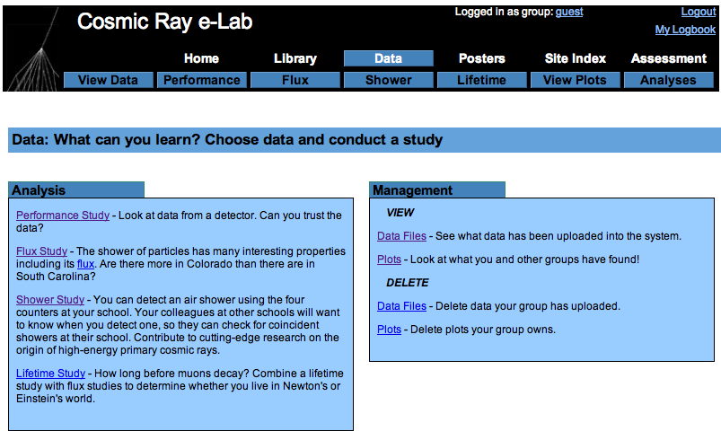
Teaching and Learning
with the Cosmic Ray e-Lab

Slide 18
Teaching and Learning
with the Cosmic Ray e-Lab
‘nother live action demo
--> PERFORMANCE study
What is this telling us?
Why do this study?
Compare? Contrast?
Notes:
Note: more plots saved under GROUP: TestTeacher.
Pick one or two from there.
Future: may need to add slide/info about blessing procedure here.

Slide 19
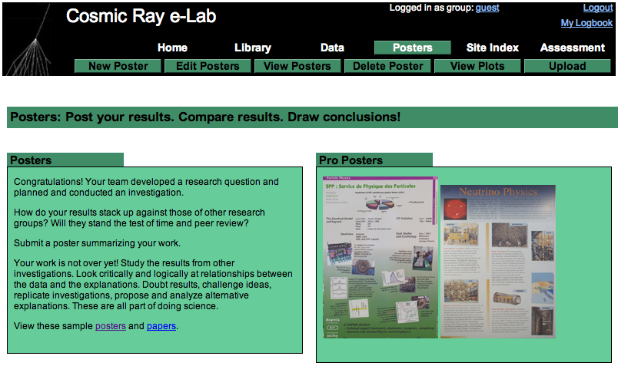
Teaching and Learning
with the Cosmic Ray e-Lab
Notes:
Show “View POSTERS” and select: all.
Good place for study ideas.

Slide 20
Teaching and Learning
with the Cosmic Ray e-Lab

Slide 21
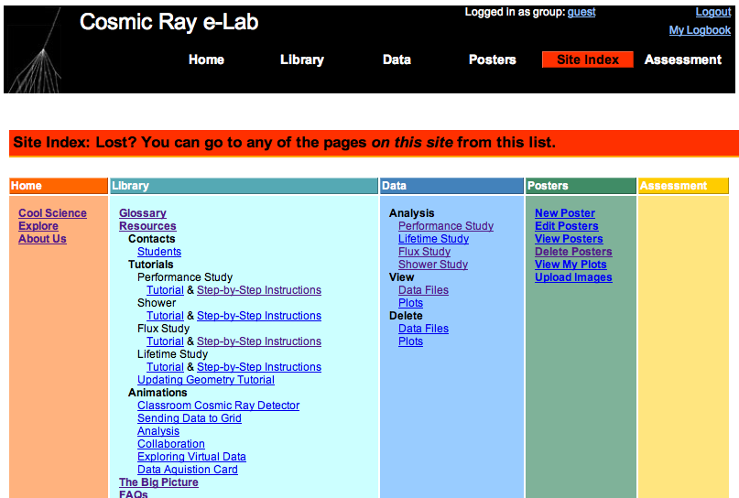
Teaching and Learning
with the Cosmic Ray e-Lab

Slide 22
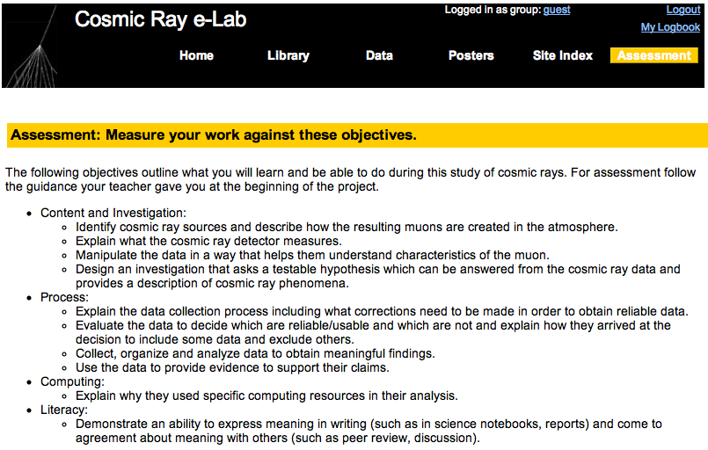
Teaching and Learning
with the Cosmic Ray e-Lab

Slide 23
Teaching and Learning
with the Cosmic Ray e-Lab
Notes:
For example, login as:
Name: Vateacher
PW: cosmic
My LogBook (upper right)
Look at both teacher and student side

Slide 24
Teaching and Learning
with Cosmic Rays
Debrief:
Summarize in LogBook

Slide 25
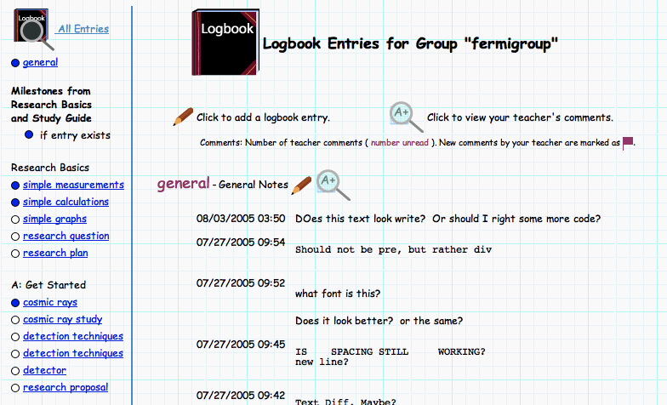
Teaching and Learning
with the Cosmic Ray e-Lab
Follow upper right: → My Logbook

Slide 26
Teaching and Learning
with the Cosmic Ray e-Lab

Slide 27
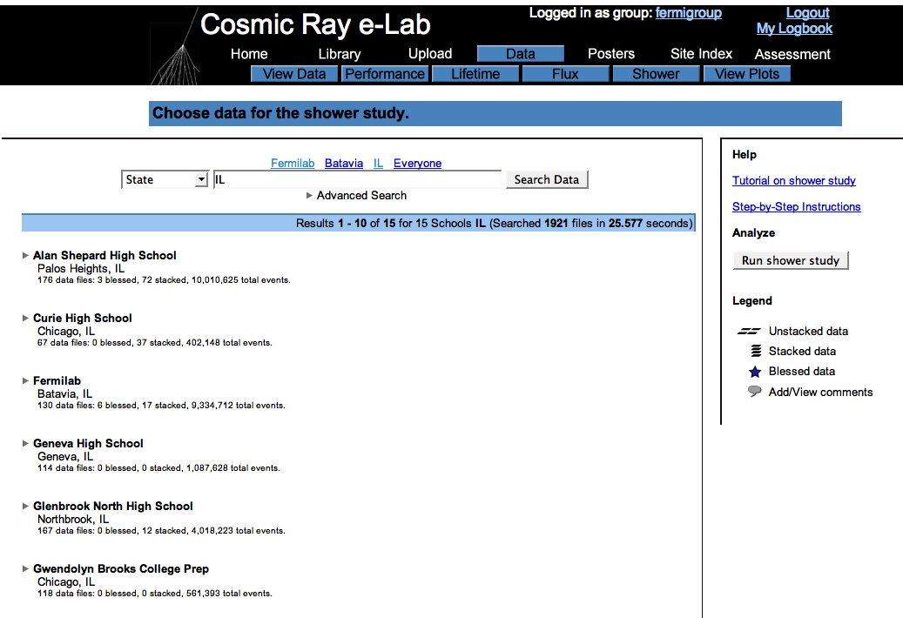
Teaching and Learning
with the Cosmic Ray e-Lab

Slide 28
Teaching and Learning
with the Cosmic Ray e-Lab
More live action --> Examples
Data Search
Shower Analysis
Flux Analysis

Slide 29
Teaching and Learning
with the Cosmic Ray e-Lab
Reproduce analysis:
--> Click on plot.
--> Run study again.
--> Change parameters.
Notes:
Go to: GROUP: TestTeacher and select PERF plot.
Rerun and change parameters.

Slide 30
Teaching and Learning
with the Cosmic Ray e-Lab
Cosmic Ray e-Lab Investigation
--> Team Task: Data Analysis
a) Pose a simple CR research question.
b) Select small CR data set.
c) Run CR analysis.
d) Save PERF and analysis plots.
e) Track your progress using the LOGBOOK.
f) Write online poster about study with plot;
include PERF and analysis plot.
g) Share “tricks of the trade” about the e-Lab.
Judge your constraints: time and $$$.
Notes:
This is the prime task for the e-Lab workshop.
Discuss how much time and planning to reach the final presentation.
!! If this is a “newbie” group, stay away from LIFETIME. Focus on FLUX, SHOWER. !!
During presentation: highlight “how to do” things that users learned within the e-Lab.

Slide 31
Teaching and Learning
with Cosmic Rays
Debrief:
Summarize in LogBook

Slide 32
Teaching and Learning
with the Cosmic Ray e-Lab
Cosmic Ray e-Lab Investigation
--> Teacher Task: Implementation Plan
Teacher Home: Community --> “Required Elements for an Implementation Plan”
Load --> Community Forum: Workshop Deliverables
. . . do not yet have an account, you can create one here.
Invitation Code: inquiry
Password: same as your e-Lab password !!
!! Minimum 6 character: alpha/numeric; no spaces !!
Guiding Questions:
How would you use the CR e-Lab in your classroom?
How do the learner outcomes apply to your activity?
What makes self-guided research beneficial?
Highlight one interesting feature you found in the QN e-Lab.
Notes:
Second Task.
This is a must for NSF evaluation!!!

Slide 33
Teaching and Learning
with the Cosmic Ray e-Lab
Implementation Plan
Science Experiment Goals: In one or two sentences, describe or list the goals of the science experiment to which this e-Lab is related.
Grade(s)/Context: (Such as Science Club) in which you will implement the e-Lab.
Challenges: To implementing the e-Lab.
When/Where: You implement the e-lab (e.g., after the AP exam in the spring for two weeks before the end of school).
Learning Objectives: (What will you expect students to know and be able to do as a result of conducting the e-Lab).
Standards: (Whichever ones you are being held responsible for) being addressed.
Steps: In the plan (e.g., 1. assess prior knowledge by?; 2. provide background information by?; 3.?4.?5. have students complete the poster).
Notes:
Second Task.
This is a must.

Slide 34
Teaching and Learning
with the Cosmic Ray e-Lab
CRMD/e-Lab Workshop Deliverables
Every project constrained: time and $$$
Cosmic Ray e-Lab Investigation
--> Team Task: POSTER
--> Teacher Task: Implementation Plan
--> Community Forum: Workshop Deliveriables
Workshop Evaluation --> Participants:
http://www13.i2u2.org/cosmic/library/upload/4/45/QNetSurveyforFellows_061207.doc
Workshop Report --> Fellow:
http://www13.i2u2.org/cosmic/library/upload/f/f0/Fellows-wkshop-form.doc
CRMDs --> Center placement list and plan

Slide 35
Teaching and Learning
with Cosmic Rays
Debrief:
Summarize in LogBook

Slide 36
Teaching and Learning
with the Cosmic Ray e-Lab
Workshop Review --> How’d we do?
Assemble CRMD: plateau, geometry, data-take.
Record progress: LogBook.
Design investigation: search data, use analysis.
Write poster, present results.
Share “Implementation Plan” for the e-Lab.
Notes:
Share cross learning.

