Slide 1
Cosmic Rays
Basic particle discovery

Slide 2
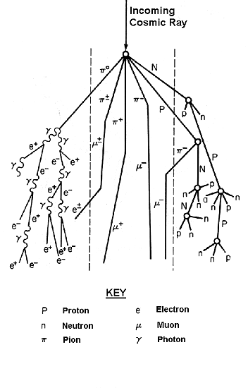
Cosmic Rays at Earth
Cosmic Rays at Earth
Primaries (protons, nuclei)
Secondaries (pions)
Decay products (muons, photons, electrons)
1-2 μ per second

Slide 3
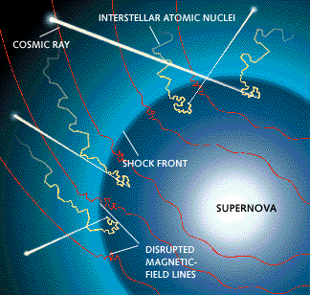
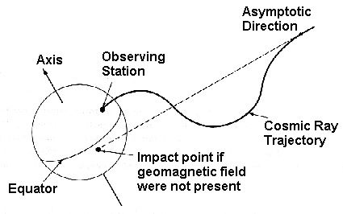
Sources of Cosmic Rays
Sources of Cosmic Rays
Supernova remnants
Active galaxies (?)
Quasars (?)
Gamma Ray Bursters (?)
Dark Energy (?)

Slide 4
What are Cosmic Rays?
Particles accelerated in astrophysical sources incident on Earth’s atmosphere
Possible sources include solar activity, supernovae, rotating neutron stars, and black holes
Composition: primarily protons and helium nuclei. Remainder is composed of heavier nuclei and electrons

Slide 5
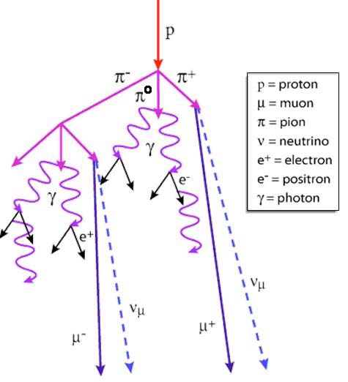
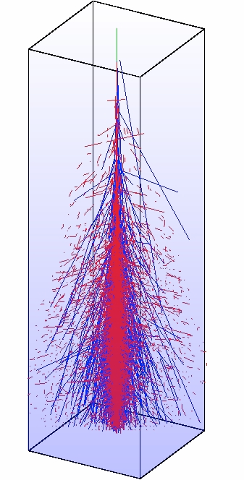
Air Shower
Secondary particles are produced, primarily pions
The neutral pions decay to photons, which produce electrons and positrons
The charged pions decay to muons via the weak reactions

Slide 6
Air Shower
The pions decay before they reach sea level
The photons, electrons, and positrons are absorbed by the atmosphere due to interactions with atomic fields
The muons can reach sea level because:
1) Even though they decay, they have sufficiently long lifetime such that the more energetic muons reach sea level before decaying
2) Unlike electrons (which are much lighter) they do not interact with atomic fields so easily
The neutrinos interact only weakly, so they easily reach sea level (and continue straight through the earth)

Slide 7
Particle Fluxes
At sea level (altitude 0) the muon and neutrino flux dominates
Approximately one cosmic ray muon passes through your thumbnail every minute!

Slide 8
Muon Decay
Muons decay with a mean lifetime of 2.2 μs(mean lifetime = time for an assembly of decaying particles to be reduced by a factor of e)
If a muon is created in the upper atmosphere (e.g. at h = 10 km) does it make it to sea level?
We would expect that even if the muons are traveling at close to the speed of light, the average distance they would travel before decaying is 5 km.
i.e. they would not make it to sea level

Slide 9
Special Relativity
According to special relativity, from our point of view time passes more slowly in a system that is in motion relative to us
Thus, the moving muon “clock” ticks more slowly.
This effect is called time dilation and is described by the simple formula need formula
Thus, the faster moving muons (e.g. those with speed v=0.998c) will travel on average (c=speed of light=3X10⁸meter/sec)
So, the faster moving muons make it to sea level!

Slide 10
Energy Spectrum of Cosmic Rays
Cosmic rays can have energies above 10²⁰eV. Far higher than energies of beams available in modern accelerators
(eV (electron Volt) is a measure of energy commonly used for particles)

Slide 11
Cosmic Ray Energy comparison
LHC at CERN pp collider with CM energy of 14 TeV
LHC (Large Hadron Collider)
pp (proton – proton)
CM (Center of Mass)
T=Terra=10¹²
Cosmic rays are equivalent to pp collider with CM energy of 433 TeV ( approx 30 times greater)

Slide 12
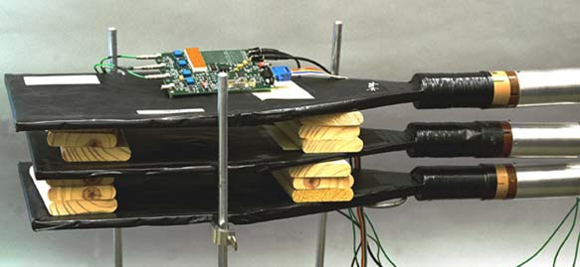
QuarknetCosmic Ray Detector
Our Quarknet cosmic ray detector is a simple “benchtop” detector consisting of scintillation detectors read out using photomultiplier tubes

Slide 13
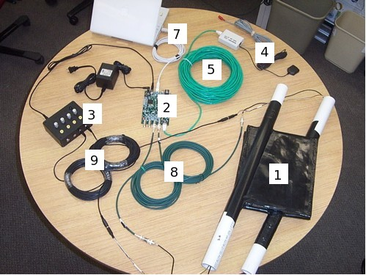
Cosmic Ray Muon Detector (CRMD)
CRMD
Typical QuarkNet Detector Setup
Counters-scintillators,
photomultiplier tubes
(two shown)
2. QuarkNet DAQ board
3. 5 VDC adapter
4. GPS receiver
5. GPS extension cable
6. RS-232 cable (to link
to computer serial port)
7. Optional RS-232 to USB adapter
(to link to computer USB port
instead of serial port)
8. Lemo or BNC signal cables
9. Daisy-chained power cables

Slide 14
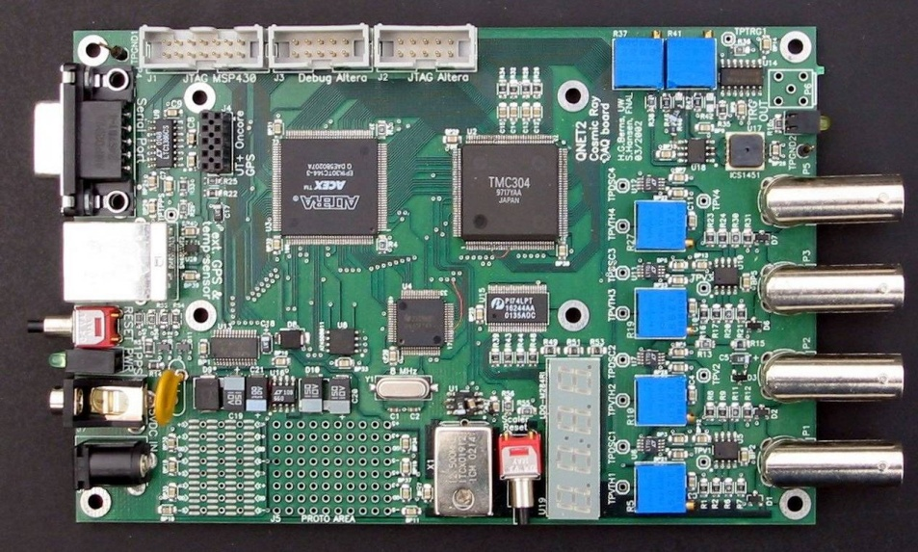
Data Acquisition(DAQ) Card
DAQ hardware measures:
Light pulse timing.
Ambient temperature.
Atmospheric pressure.
Experiments include:
Flux studies.
Time correlation.
Shielding.
Particle speed.
Particle lifetime.
Altitude attenuation.

Slide 15
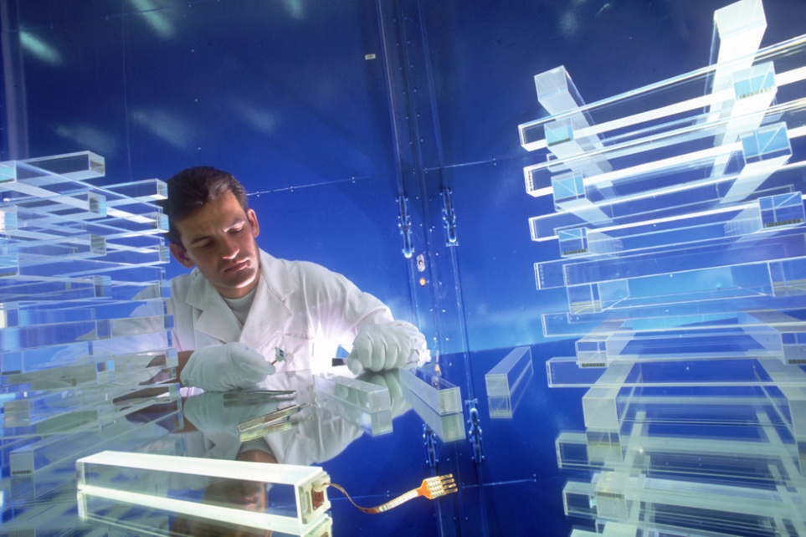
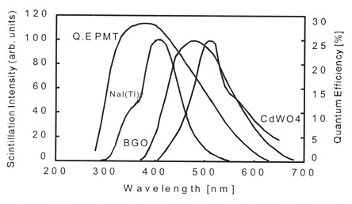
Scintillators
Produce a short pulse of light in response to charged particle passing through
Two types: inorganic and organic
Organic scintillator (used in our detector):Typically plastic doped with dye molecules
Mechanism is excitation of molecular levels in primary fluorescent material which decay with emission of UV light
Conversion to visible light achieved via fluorescent excitation of dye molecules ( “wavelength shifters”)

Slide 16
Photomultiplier Tube
Photon incident on photocathode
Liberates electrons by photoelectric effect
Electrons accelerated to 1st dynode
Secondary electrons emitted
Using ~12 stages can get amplification of ~10⁷–10⁸ times
Electron cascade collected at anode –induces signal

Slide 17
Counter Configuration
Types of Counter Configurations:
1) Array --> shower
Counters distributed in the same plane
2) Stacked --> flux
Counters spaced on common center
Determined by type of study
Student defined

Slide 18
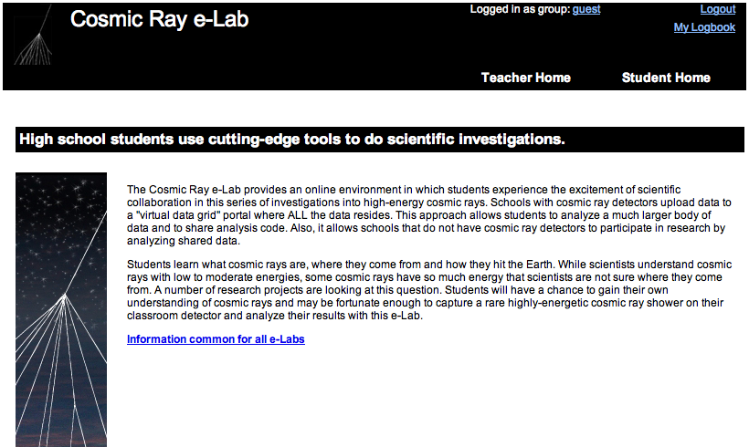
Cosmic Ray e-Lab
http://www.i2u2.org/elab/cosmic

