Slide 1
Cosmology
Big Bang and the Expanding Universe
Richard Lasky – Summer 2010

Slide 2
Cosmology
General Relativity serves as the foundation for modern Cosmology
Cosmology is the study of the universe as a whole
It deals with:
A search to understand:
The observed universe
Its origin
Its future

Slide 3
The Big Bang
The idea that the universe had a beginning was first suggested by the general theory of relativity
Physicists believe that the universe began as a tiny dense point which expanded outward to produce the vast structure we see today
http://www.youtube.com/watch?v=hSZqhqR5XKM&NR=1

Slide 4
Expanding Universe
The galaxies we see in all directions are moving away from the Earth, as evidenced by their red shifts
The red shift is apparently a Doppler shift and indicates that essentially all of the galaxies are moving away from us
Hubble determined that the red shift (recession speed) is proportional to distance
http://www.youtube.com/watch?v=iCI8K9mD_yU

Slide 5
Expanding Universe

Slide 6
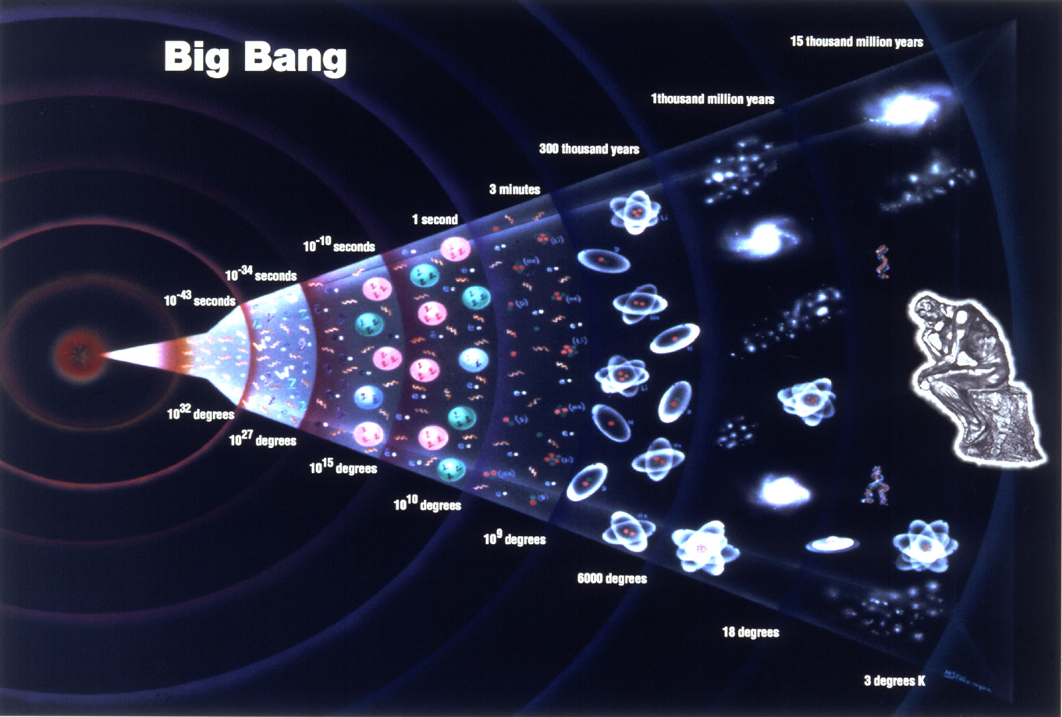
Standard model of the stages of the universe

Slide 7
Large Hadron Collider at CERN
http://www.youtube.com/watch?v=rgLdIly2Xtw&feature=related

