Slide 1
Nuclear Fission and Fusion
Richard Lasky – Summer 2010

Slide 2
Nuclear Fission
Nuclear fission is the process of splitting atoms, or fissioning them
When a nucleus fissions, it splits into several smaller fragments
These fragments, or fission products, are about equal to half the original mass
Two or three neutrons are also emitted

Slide 3
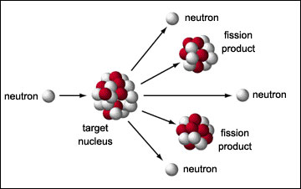
Nuclear Fission
The sum of the masses of these fragments is less than the original mass. This 'missing' mass (about 0.1 percent of the original mass) has been converted into energy according to Einstein's equation

Slide 4
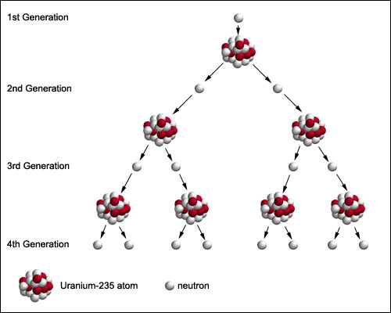
Nuclear Chain Reactions
A chain reaction refers to a process in which neutrons released in fission produce an additional fission in at least one further nucleus
This nucleus in turn produces neutrons, and the process repeats

Slide 5
Energy Released From Each Fission
165 MeV ~ kinetic energy of fission products 7 MeV ~ gamma rays 6 MeV ~ kinetic energy of the neutrons 7 MeV ~ energy from fission products 6 MeV ~ gamma rays from fission products 9 MeV ~ anti-neutrinos from fission products
200 MeV
1 MeV (million electron volts) = 1.609 x 10 ⁻¹³ joules

Slide 6
Nuclear Chain Reactions
The process may be controlled (nuclear power) or uncontrolled (nuclear weapons)

Slide 7
Critical Mass
Although two to three neutrons are produced for every fission, not all of these neutrons are available for continuing the fission reaction
At the point where the chain reaction can become self-sustaining, this is referred to as critical mass
A sphere has the minimum possible surface area for a given mass
surround the fissionable material with a suitable neutron "reflector“
only about 11 pounds (5 kilograms) of nearly pure or weapon's grade plutonium 239 or about 33 pounds (15 kilograms) uranium 235 is needed to achieve critical mass
An Atomic Bomb

Slide 8
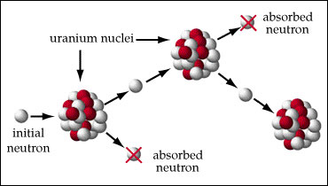
Controlled Nuclear Fission
To maintain a sustained controlled nuclear reaction, for every 2 or 3 neutrons released, only one must be allowed to strike another uranium nucleus
If this ratio is less than one then the reaction will die out; if it is greater than one it will grow uncontrolled (an atomic explosion)
A neutron absorbing element must be present to control the amount of free neutrons

Slide 9
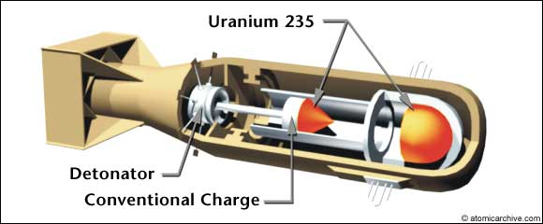
Little Boy: A Gun-Type Bomb
gun that fired one mass of uranium 235 at another mass of uranium 235, thus creating a supercritical mass

Slide 10
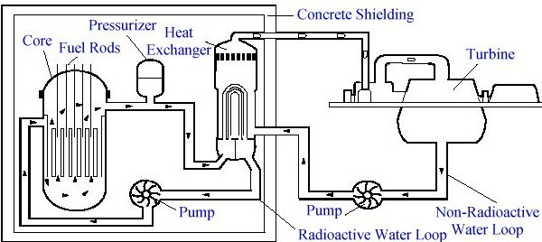
Nuclear Power Plant
The chain reaction gives off heat energy
The heat energy is used to boil water in the core of the reactor
This water from around the nuclear core is sent to another section of the power plant
In the heat exchanger, it heats another set of pipes filled with water to make steam
The steam in this second set of pipes turns a turbine to generate electricity

Slide 11
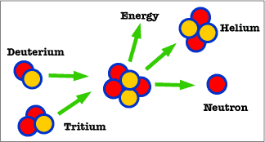
Nuclear Fusion
Fusion means joining smaller nuclei (the plural of nucleus) to make a larger nucleus
The sun uses nuclear fusion of hydrogen atoms into helium atoms
This gives off heat and light and other radiation

Slide 12
Videos
http://www.teachersdomain.org/asset/phy03_vid_fission/
http://www.youtube.com/watch?v=mcxAlD7zQUQ&feature=related
http://www.youtube.com/watch?v=OOf-tIj-JQU&feature=related
http://www.youtube.com/watch?v=vDAZsPkTkMM&feature=related

Slide 13
Accelerators
http://www.google.com/imgres?imgurl=http://www2.slac.stanford.edu/vvc/art/simplemodel2.gif&imgrefurl=http://www2.slac.stanford.edu/vvc/theory/fundamental.html&h=314&w=288&sz=18&tbnid=wYM1ORfT4RYDfM:&tbnh=117&tbnw=107&prev=/images%3Fq%3Delementary%2Bparticles&hl=en&usg=__UGLBHsqhD1jyrVAVk7bYMhOv1Vo=&sa=X&ei=C-sOTOWPI8OHnQf-hM2yDQ&ved=0CDgQ9QEwBA

