Slide 1
Nuclear Physics and Radiation
Richard Lasky – Summer 2010

Slide 2
Nuclear Structure
The nucleus is composed of particles called nucleons
Electrically charged are called protons
No electrical charge are called neutrons
Mass of nucleons are 2000 times the mass of electrons
So the mass of an atom is almost equal to the mass of the nucleus

Slide 3
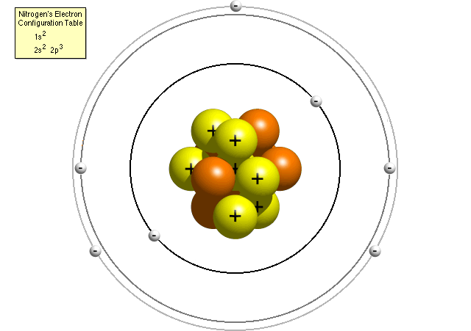
Nuclear Structure

Slide 4
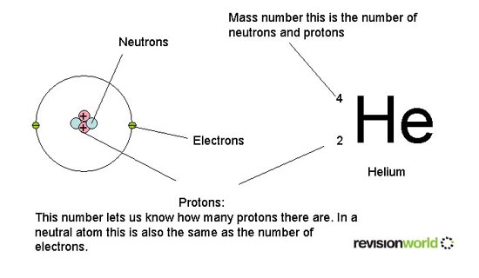
Atomic Number and Mass Number

Slide 5
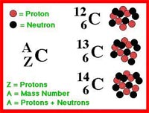
Isotopes
Nuclei that contain the same number of protons but different numbers of neutrons are called isotopes
An example of an Atom with many isotopes is Carbon
Isotopes are Rare
98.9% of naturally occurring Carbon is C12

Slide 6
Mass of the Nucleus
The mass of a nucleus is specified in unified atomic mass units(u)
1 u = 1.66 X 10⁻²⁷ kg
Or 931.5 Mev/c²
The total mass of a stable nucleus is always less than the sum of the masses of its protons and neutrons
The difference is referred to as the total binding energy

Slide 7
Total Binding Energy
The total binding energy represents the amount of energy that must be put into a nucleus in order to break it apart into separate protons and neutrons
To be stable, the mass of the nucleus must require that extra energy to break it up

Slide 8
Calculation of binding energy
Calculation of Binding Energy
For a particle 4He:
Calculated mass of 2 protons and 2 neutrons:
proton = 1.007276470 gm/mole.
neutron = 1.008665012 gm/mole
.Mass calculated
2 proton 2 neutron
mass calculated = 4.032 gm/mole
Calculate binding energy:
E = m c²
c =2.99792458 x 10⁸ m/sec . 1
mass defect
E = m c²
E = 2.73 X 10⁻¹² joule/ mole

Slide 9
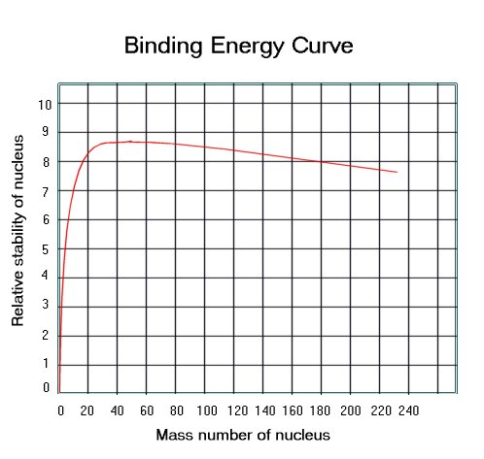
Average binding energy per nucleon
The greater the binding energy per nucleon of an atom, the greater it's stability
The average energy/nucleon increases as A increases up to plateau of 8.7 Mev
After that it decreases slightly

Slide 10
Stability of the nucleus
Since protons are positively charged !!!
Why don’t the protons repel each other causing the nucleus to come apart?
The strong nuclear force holds all nucleons (protons and neutrons) together
This force is:
stronger than the electrical force
It is short range
This is compared to electrical and gravitational forces that are long range

Slide 11
Forces in nature
There is another nuclear force that shows up with some radioactivity called the weak nuclear force
Four known forces in nature
Strong nuclear
Weak nuclear
Electromagnetism
Gravity

Slide 12
Radioactivity
First discovered by Henri Becqurerel in 1896
Found that uranium would darken a photographic plate through a protective wrapping
Next Marie Curie and Pierre Curie isolated two unknown elements that were radioactive
Polonium and Radium
They discovered that the source of radioactivity is deep within the nucleus and is the result of the disintegration or decay of an unstable nucleus
Radioactive isotopes occur in nature or can be produced in the laboratory
http://www.youtube.com/watch?v=lFXUfK_C8jY

Slide 13
Radioactivity
The three types of radiation are named after the first three letters of the Greek alphabet
Alpha – α
Positively charged
Nuclei of helium atoms
Barely penetrate a piece of paper
Beta – β
Negatively charged
Electrons
Pass through 3mm of aluminum
Gamma – γ
Neutral
High energy photons
Extremely penetrating - pass through several centimeters of lead
http://www.neok12.com/php/watch.php?v=zX557e4374675e794c186673&t=Radioactivity

Slide 14
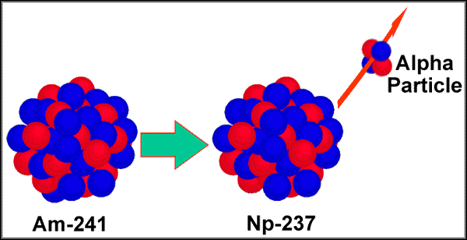
Alpha Decay
When a nucleus emits an α-particle it will be very different because it loses two protons and two neutrons
The spontaneous emission of an alpha particle occurs in elements of mass number greater than about 150, such as uranium, thorium, and plutonium.
The reason alpha decay occurs is because the nucleus has too many protons which cause excessive repulsion. In an attempt to reduce the repulsion, a Helium nucleus is emitted.

Slide 15
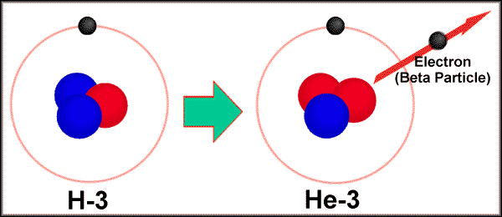
Beta Decay
Beta decay occurs when the neutron to proton ratio is too great in the nucleus and causes instability
In basic beta decay, a neutron is turned into a proton and an electron

Slide 16
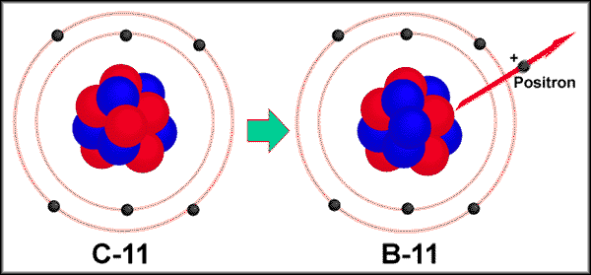
Beta Decay/Positron emission
There is also positron emission when the neutron to proton ratio is too small
A proton turns into a neutron and a positron and the positron is emitted
A positron is basically a positively charged electron

Slide 17
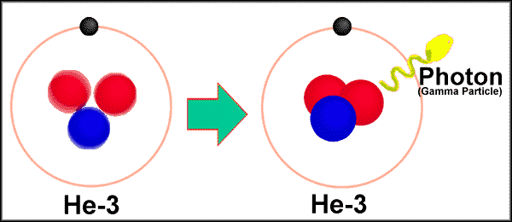
Gamma Decay
Gamma decay occurs because the nucleus is at too high an energy
The nucleus falls down to a lower energy state and, in the process, emits a high energy photon known as a gamma particle
http://video.google.com/videoplay?docid=4233777797536713826#

Slide 18
Radiation Effects on Humans
The unit used to measure radiation dosage is the rem
stands for roentgen equivalent in man
represents the amount of radiation needed to produce a particular amount of damage to living tissue
the total dose of rems determines how much harm a person suffers
A Geiger counter is used to measure radiation
A dosimeter is used to measure radiation on a person

Slide 19
Effects of Radiation Exposure on Human Health
dose of just 25 rems causes some detectable changes in blood
doses to near 100 rems usually have no immediate harmful effects
doses above 100 rems cause the first signs of radiation sickness including:
nausea
vomiting
headache
some loss of white blood cells

Slide 20
Effects of Radiation Exposure on Human Health
Doses of 300 rems or more cause temporary hair loss, but also more significant internal harm, including damage to nerve cells and the cells that line the digestive tract. Severe loss of white blood cells, which are the body's main defense against infection, makes radiation victims highly vulnerable to disease. Radiation also reduces production of blood platelets, which aid blood clotting, so victims of radiation sickness are also vulnerable to hemorrhaging
Half of all people exposed to 450 rems die
doses of 800 rems or more are always fatal
http://www.youtube.com/watch?v=l93naDmFgzE&feature=related

Slide 21
Radioactive Decay
The nuclei of radioactive isotopes do not all decay at the right time
Like any atomic process this is random
We can’t predict when a given nucleus will decay
But we can determine, on probabilistic basis, approximately how many will decay over a certain time period

Slide 22
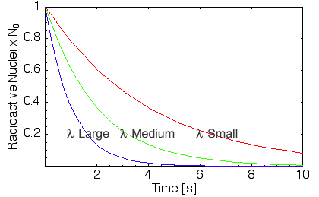
Half Life
The number of decays ∆N that occur in a short interval ∆t is proportional to the total number N of radioactive material present
∆N = - λN ∆t
λ = decay constant

Slide 23
Radioactive Decay Law
http://www.youtube.com/watch?v=515BlcHomw8&feature=related

Slide 24
Half Life
The half-life of an isotope is defined as the time it takes for half the original amount of isotope to decay
The half life is related to the decay constant by this formula:
T(½) = .693/λ
http://www.lon-capa.org/~mmp/applist/decay/decay.htm

