Slide 1
Welcome to Quark Net 2011
Wayne State University Physics Department

Slide 2
Agenda for Today
9 – 10 Welcome / Introductions / paperwork / ND Pre-test
10- 11 Explain goal of program
Introduce e-Lab
elab pretest
11 – 12 Cosmic Ray Intro
12 – 1 Lunch
1 – 3 Rebuild Detectors
3 - 4 Start Plateauing CRMD

Slide 3
Goals for Workshop
Develop a deeper understanding of Physics content
Introduction to Inquiry based learning
Introduction to elementary particles
Methods of experimentation with particles
Overview of current Physics experimentation
FermiLab
CERN

Slide 4
Teaching and Learning
with Cosmic Rays
Workshop Expectations:
Full attendance is required – all two weeks
Hours and schedule: 9:00 – 4:00 (ish)
Start everyday in Physics Room 115
No other distractions
Notes:
Slide lining out workshop expectations:
-- success and skill requires full attendance
-- hours and schedule
-- need to focus only on CRMD and e-Lab
-- no other distractions
-- group can meet at another time for other stuff
If the site manager has followed the “boilerplate” then the
above will not be a surprise

Slide 5
Teaching and Learning
with Cosmic Rays
Workshop Goals for Students:
Learn and Understand:
The nature of particle Physics
The methods of good scientific inquiry
Conduct Research on Cosmic ray activity
Assemble Cosmic Ray Muon Detectors
Learn the operation of the equipment and the software
Prepare a report (PowerPoint) summarizing:
What was learned
The research conducted and the results

Slide 6
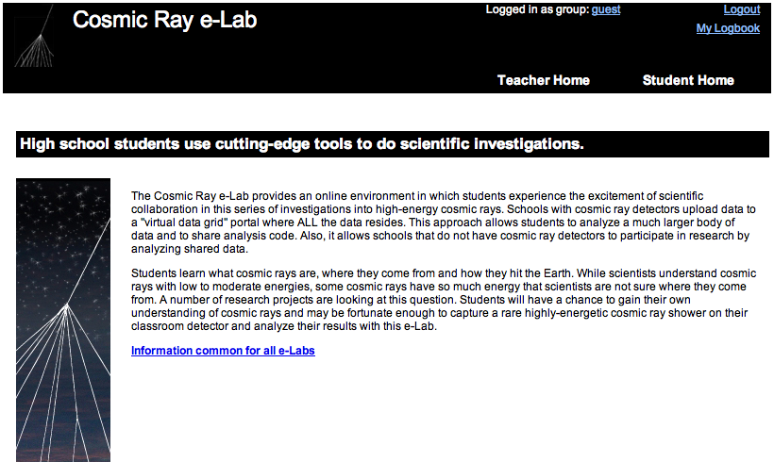
Cosmic Ray e-Lab
http://www.i2u2.org/elab/cosmic
Notes:
6

Slide 7
Cosmic Ray e-Lab
http://www.i2u2.org/elab/cosmic
Team 1: Mohamed Ali-Hussein & Ayasha Jabber
Log in: Hamtramck
Password: condheat
Team 2: Ali Elreichouni & Kayla Price
Log in: WSU Session 3
Password: cosmic
Go online now and take the pretest.
Notes:
7

Slide 8
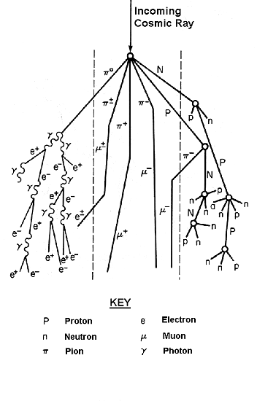
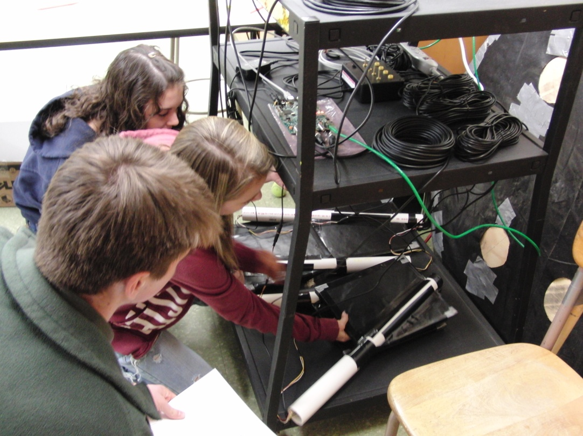
Teaching and Learning
with Cosmic Rays
Cosmic Ray e-Lab
Notes:
Private talk to ‘S’s: Most secret place in school? --> ‘T’ lounge. This is a ‘T’ workshop, but you get to listen in.
‘S’s most important here; you get to teach the ‘T’s.

Slide 9
Teaching and Learning
with Cosmic Rays
QuarkNet Overview
QuarkNet Cosmic Ray Detector
Assemble CRMD hardware and take data.
Cosmic Ray e-Lab Exploration
Upload and analyze data.

Slide 10
Teaching and Learning
with Cosmic Rays
Workshop Objectives:
Assemble CRMD: plateau, geometry, data-take.
Record progress: LogBook.
Design e-Lab investigation: data, tools, plots.
Write report, present results.
Share “Implementation Plan” and strategy.
Notes:
Pass on Plateauing if the workshop is constrained.
Leave the group with the e-Lab Fellows powerpoint and spreadsheet.
!! search data, analysis tools, save plots !!

Slide 11
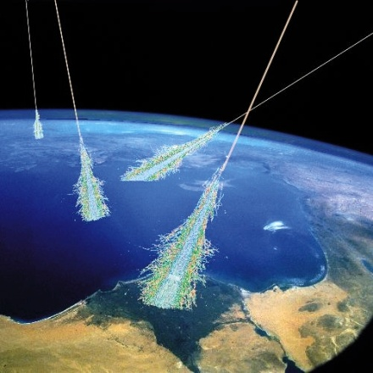
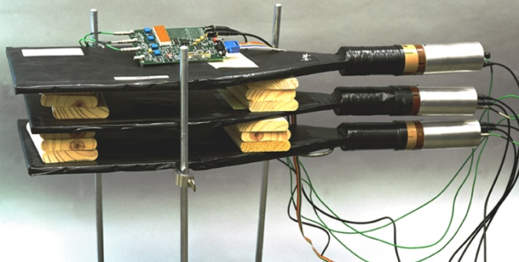
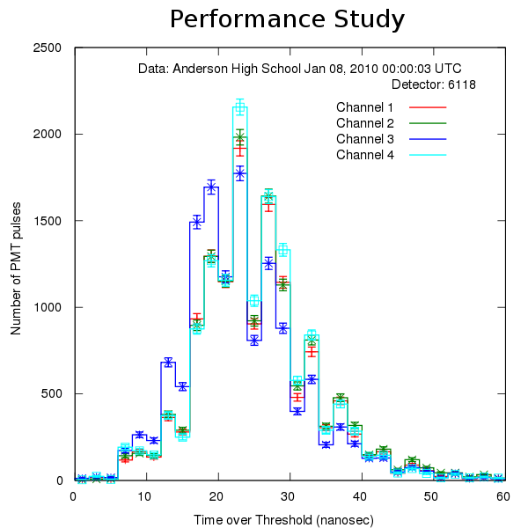
Teaching and Learning
with Cosmic Rays
Cosmic Rays
Sources
Composition, energy spectrum
Detection
Current experiments
The QuarkNet Classroom Detector
Hardware overview
Classroom use
Experiments, measurements
Data Analysis
Upload, analyze data & save data products.
Share results.
Enter logbook notes.
Notes:
CONNECTS: PARTICLES <--> HARDWARE <--> SOFTWARE

Slide 12
Teaching and Learning
with Cosmic Rays
Cosmic Ray e-Lab Stats: May 2010
774 teachers accounts
1,515 student research groups
519 DAQs worldwide
335 detectors in high schools
27,548 data files
498 posters

Slide 13
What is Quarknet?
QuarkNet creates a collaboration of users:
Teachers ←→ Students
Teachers ←→ Mentor Scientists
Detector Schools ←→ Non-Detector Schools
World-wide Network: Students ←→ Students

Slide 14
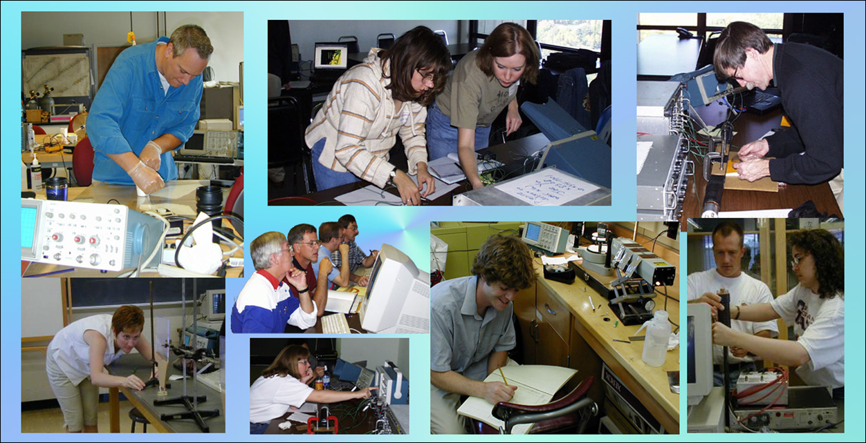
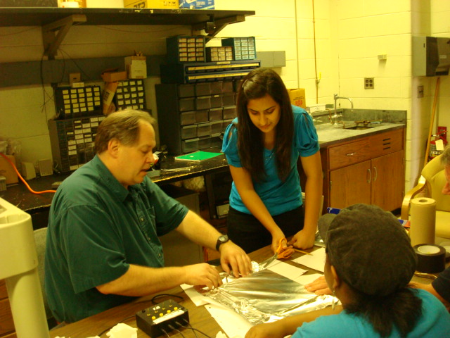
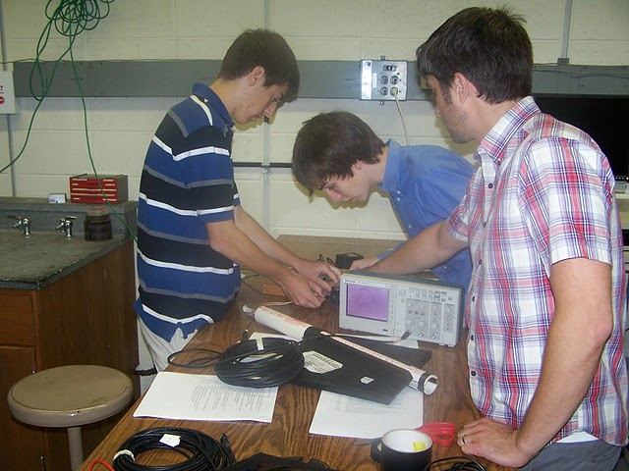

Slide 15
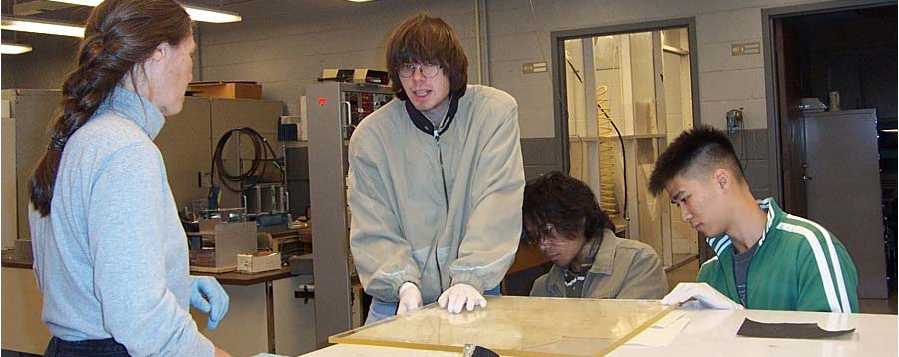
Physicists, teachers & their students collaborate on research projects and investigations.
Scientists as mentors
Teachers as researchers & facilitators
Students as researchers

Slide 16
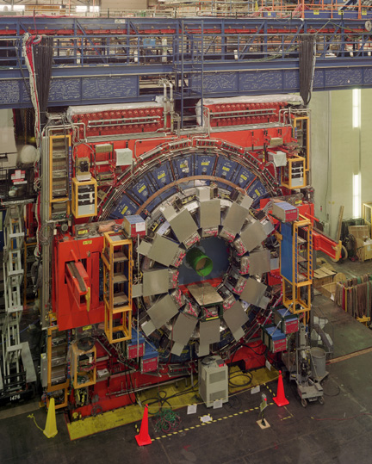
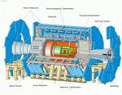
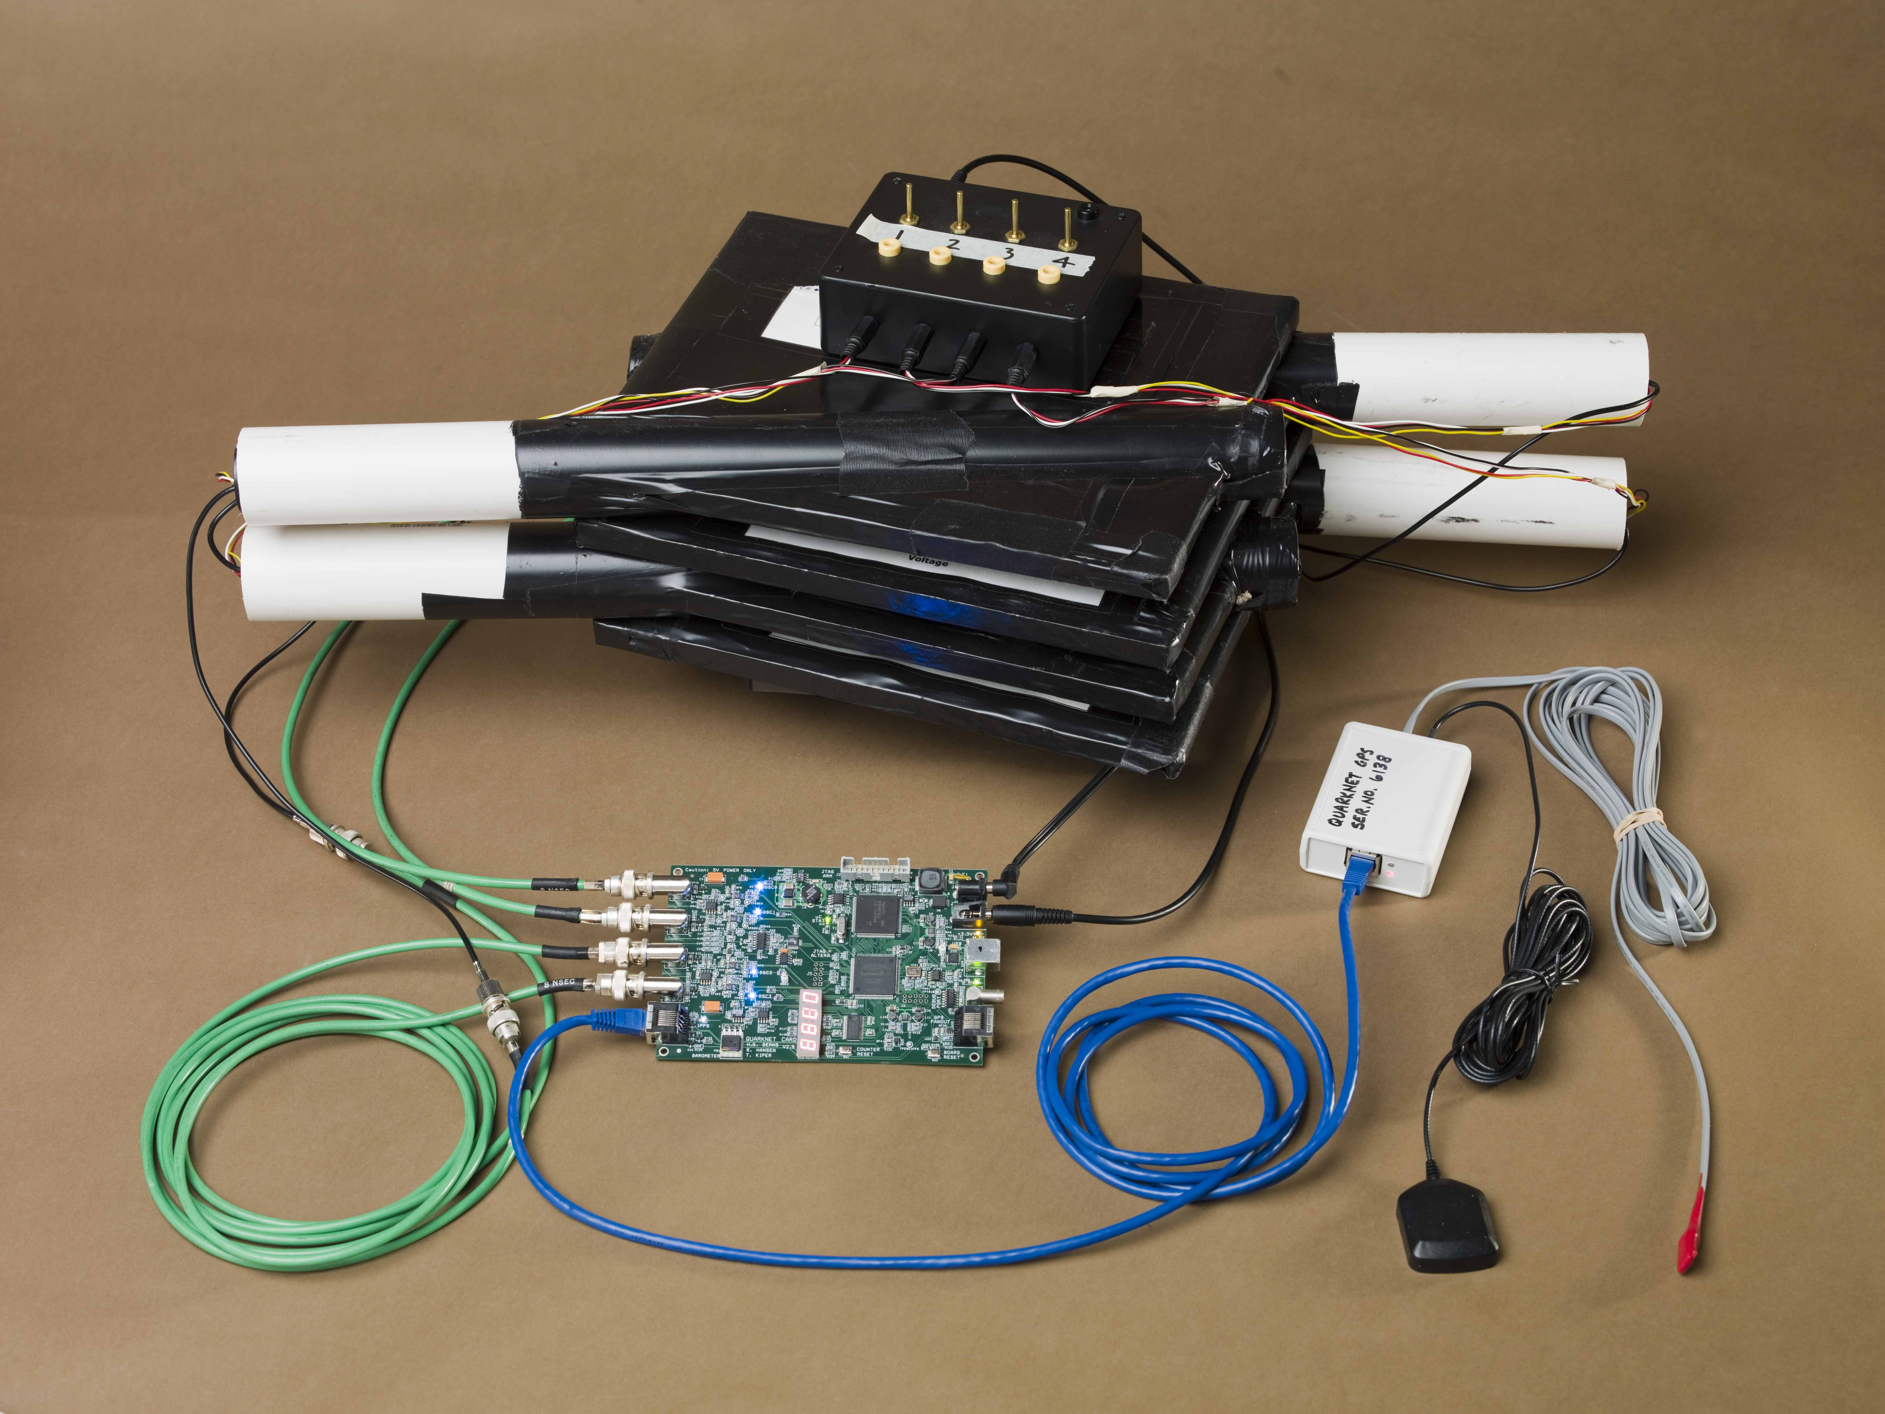
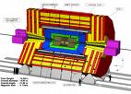
Teaching and Learning
with Cosmic Rays
CRMD Expectation:
→ Not “plug & play”
→ Assembling and thinking required
Direct analogue of the big Tevatron & LHC detectors
CDF ATLAS CMS QuarkNet
Note: Images are not to scale
Notes:
16

Slide 17
Vision
A lasting community of researchers that includes high school teachers and students as well as physicists
“Doing science.”
School science reflects the
practice of science. Science
Is what students DO, not
what is done to them.

Slide 18
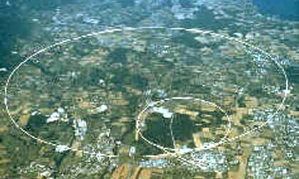
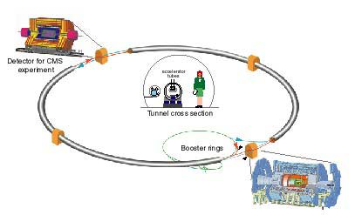
Why QuarkNet?
Our understanding of the universe is changing as a new accelerator, the LHC, and its experiments, ATLAS, CMS, ALICE and LHCb, gather data.
Join particle physicists to work on physics projects exploring the nature of matter, energy, space and time.

Slide 19
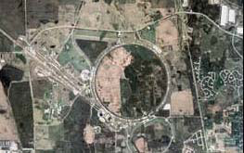
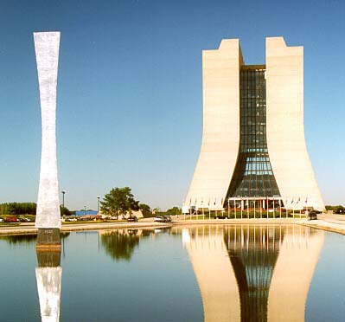
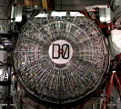
QuarkNet Origins
CDF & DØ
at
Fermilab

Slide 20
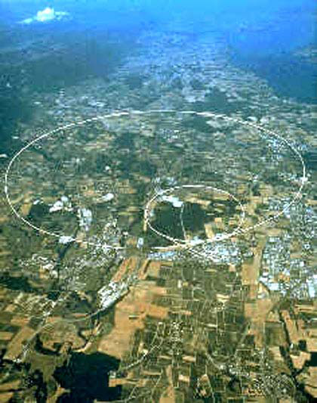
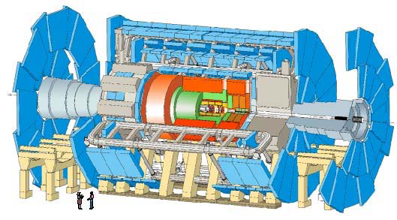
Quark Net Origins
ATLAS and CMS at CERN

Slide 21
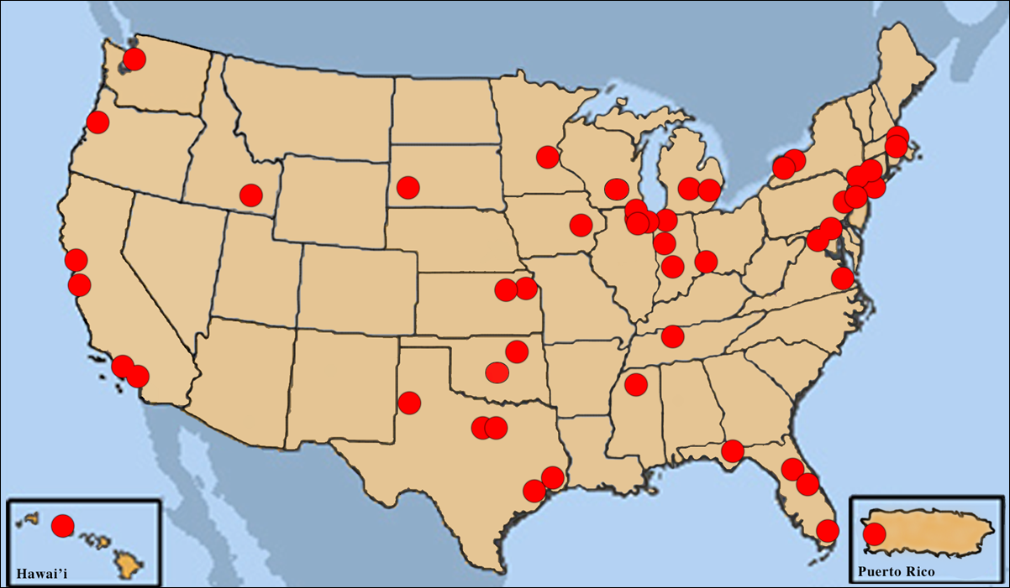
Current Active Centers

Slide 22
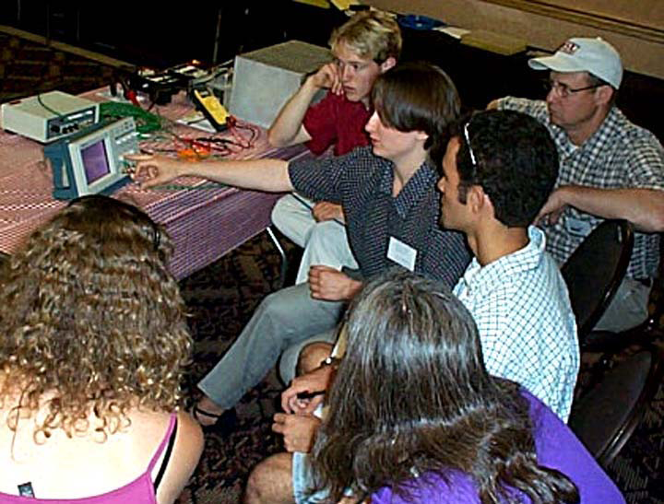
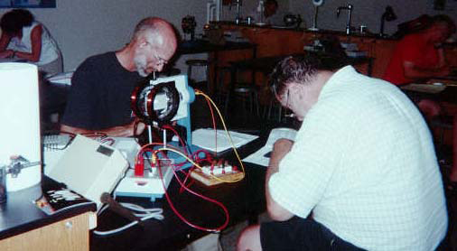
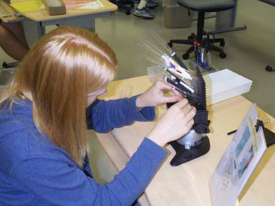
Current Status
53 Active centers
158 Mentors
615 Teachers
108 Summer students

Slide 23
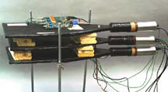
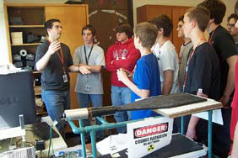
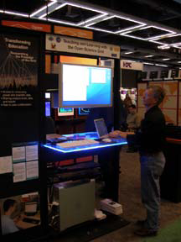
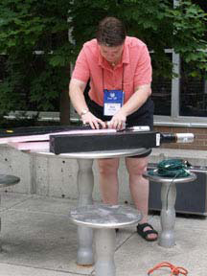
The QuarkNet Collaboration
Cosmic Ray Detector
Teachers’ idea
Several prototypes
Collecting data led to e-Lab

Slide 24
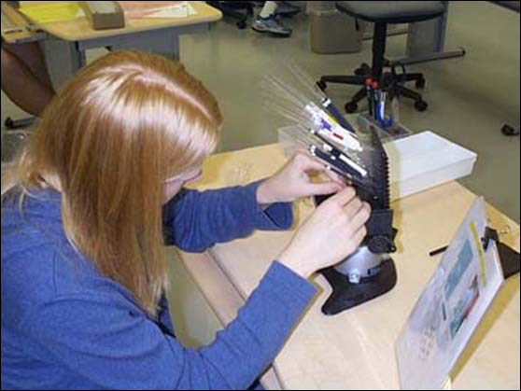
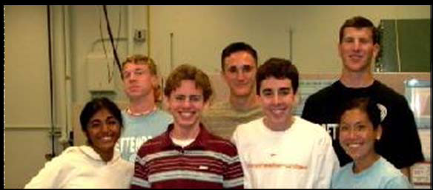
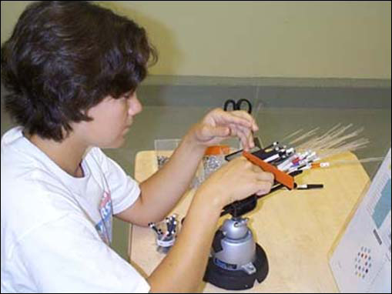
Student Summer Research
11 centers with 4 student slots each (avg)

Slide 25
Teaching and Learning
with Cosmic Rays
Cool Science
Simulation
Notes:
25

