Slide 1
Have You Seen Higgs?
Prof. Robert Harr
Wayne State University

Slide 2
Outline (Standard Form)
The standard model of particle physics
The role of the Higgs boson in electroweak symmetry breaking
Status of searches for the Higgs boson
Summary of alternatives to the Higgs boson
And the truth about the connection of the Higgs boson to mass

Slide 3
Outline (Question Form)
What is the world composed of?
What is the theory for this composition?
Why is the Higgs boson needed?
Where does one look for the Higgs boson?
What is the status and prospects for the search?
What if no Higgs boson is found?
But what about the proton mass?

Slide 4
The Greeks

Slide 5
Four Elements
Some ancient philosophers believed all things to be mixtures of four basic elements: earth, water, air, and fire.
Vary mixture to get different substances.
This model lasted until the 18th century …

Slide 7
20th Century Physics
Atoms can be broken apart into more basic components.
Atoms composed of quarks and leptons.

Slide 8
Periodic Table, Late 20th Century
6 quarks and 6 leptons
each set comes in 2 electric charges (rows)
the basic pattern is repeated three times (columns, called generations)
not shown:
anti-particles
color charges
all are point-like particles

Slide 9
About Particle Names
quark: nonsense word taken from Joyce’s Finnegan’s Wake.
lepton: from Greek for small
meson: from Greek for intermediate
baryon: from Greek for bulky
neutrino: from Italian, diminutive form of neutral

Slide 10
How Do Particles Interact?
Particle physics view of the world:
matter particles interact by exchanging a force particle
force particles are:
photon (electromagnetism)
W±, Z⁰ (weak force)
gluon (strong force)
graviton (gravity)
represented by Feynman diagrams

Slide 11
Updated Table of Particles

Slide 12
And It Works …
from stars

Slide 13
And It Works …
to puppies
from stars

Slide 14
But How Well?
Extremely well.
All measurements agree with predictions within errors
Many measurements have 3, 4, 5, or even 6 digits.
Several measurements agree with predictions to 9 digits!

Slide 15
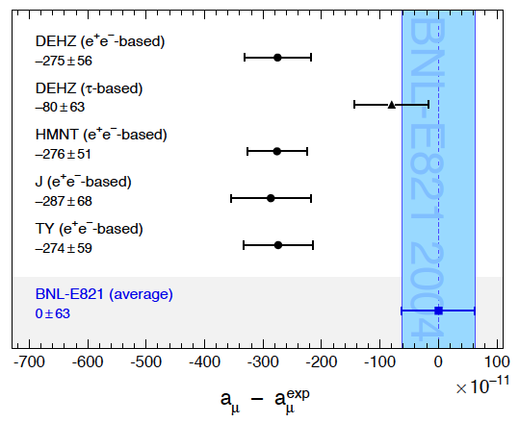
9 Digits of Agreement!

Slide 16
But There’s a Problem: Mass
For technical reasons, the theory requires all particles to have zero mass.
The Z⁰ boson definitely has non-zero mass – it has the mass of a zirconium atom (Zr).
Trick: Start with zero mass, and include something in the theory that causes the mass to become non-zero
This is called “electroweak symmetry breaking”
“Best” model based on the Higgs mechanism
New: Higgs field and Higgs boson

Slide 17
The Zero-Mass Theory

Slide 18
The Particles, Including the Higgs

Slide 19
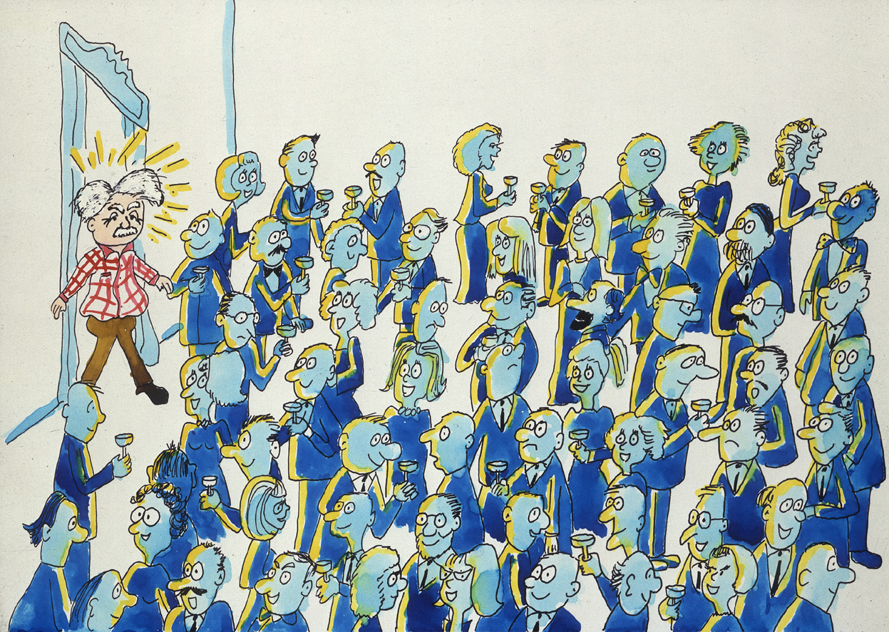
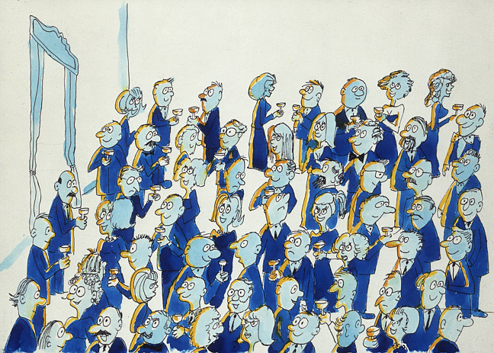
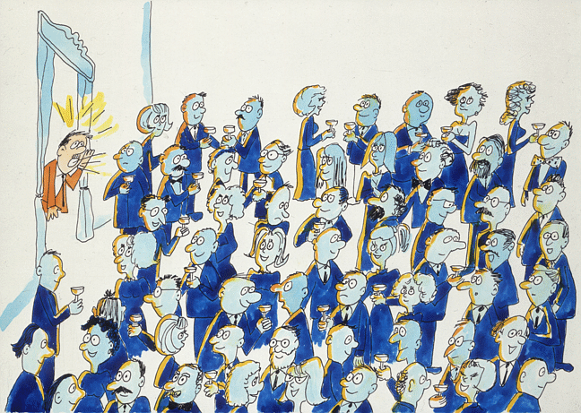
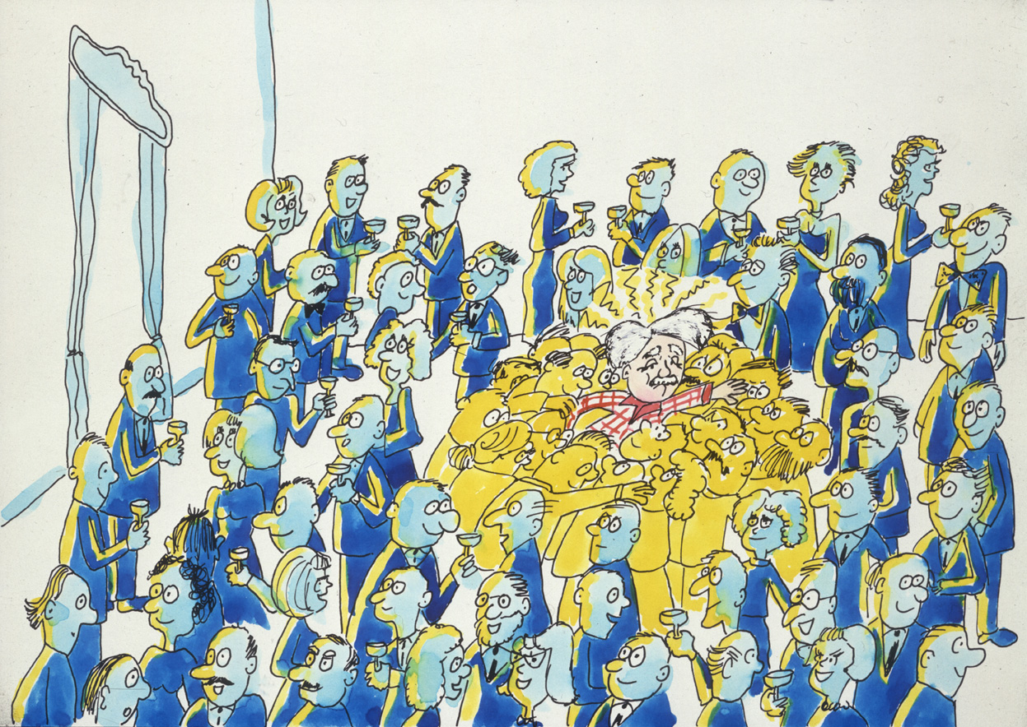
What is the Higgs Boson?
© CERN
Notes:
ANIMATED SLIDE. Non-animated version (5 slides total) available in Spare Slides section.
Five drawings that illustrate the classic Higgs field/Higgs boson analogy. For the full explanation, see http://www.hep.ucl.ac.uk/~djm/higgsa.html

Slide 20
So, Why All the Fuss?
All past searches have come up empty, but …
There are strong reasons to believe that the Higgs boson will soon be seen.
Two high energy particle accelerators are now capable of searching for the Higgs: LHC and the Tevatron.
The Tevatron is running well and the LHC is starting operation.
The Higgs mass is probably in a region accessible to experiments at both accelerators.
Eternal optimism

Slide 21
Where Can We Produce Higgs Bosons?
Particle colliders such as
LEP (pictured)
Tevatron at Fermilab
LHC at CERN
The most exhaustive searches to date were done at LEP.

Slide 22
Fermilab’s Accelerators
Tevatron

Slide 23
D0 and CDF Detectors

Slide 24
The LHC and Higgs Detectors

Slide 25
3-Dimensional View of the LHC
The Alps
P5 surface
CMS detector

Slide 26
LHC Tunnel and Dipole Magnet

Slide 28
Endcap Showing CSC Chambers

Slide 29
The Atlas Apparatus

Slide 30
Atlas Opened

Slide 31
Why is the Higgs Hard to Find?
smaller
rate

Slide 32
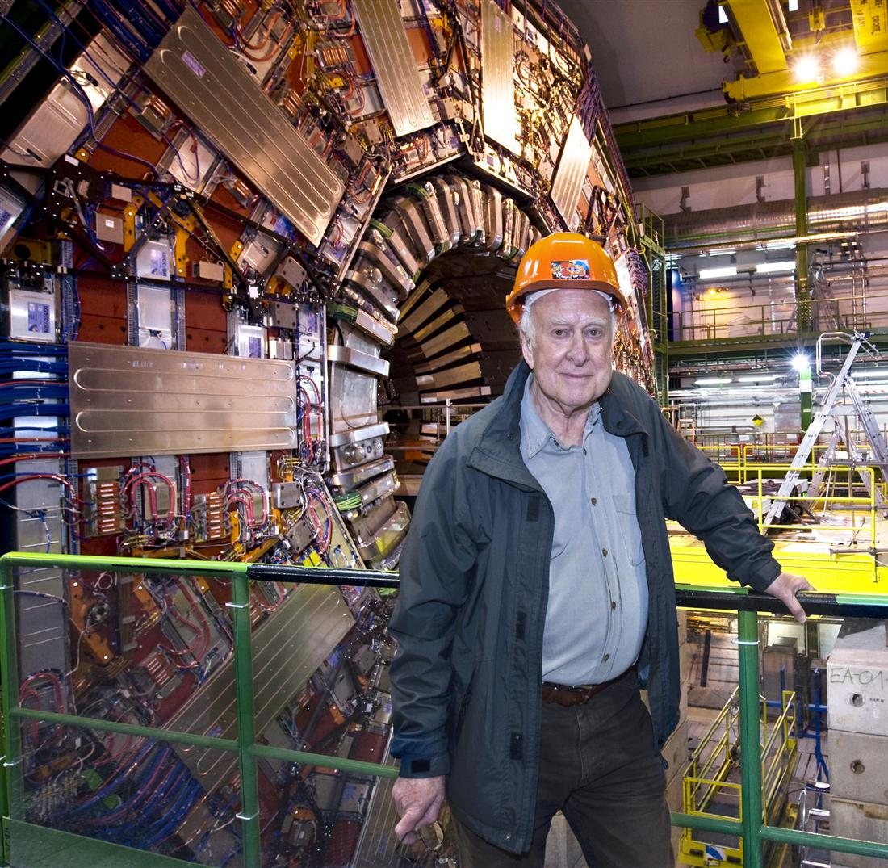
Where Is Higgs?
That is, what is the mass of the Higgs boson.
The mass is the only unknown detail
(of the standard Higgs)
Dr. Peter Higgs at the CMS experiment

Slide 33
And …
The Higgs signal depends on its (unknown) mass.
Searches must cover all the possibilities
Some are easier than others!

Slide 34
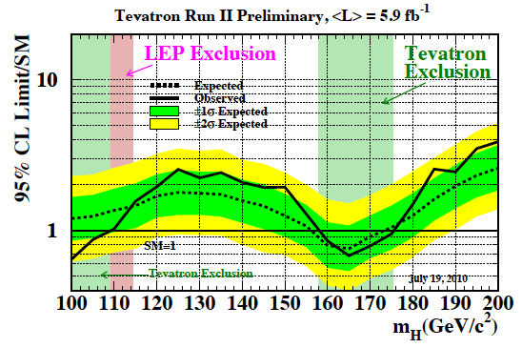
Latest Results on the Higgs Search

Slide 35
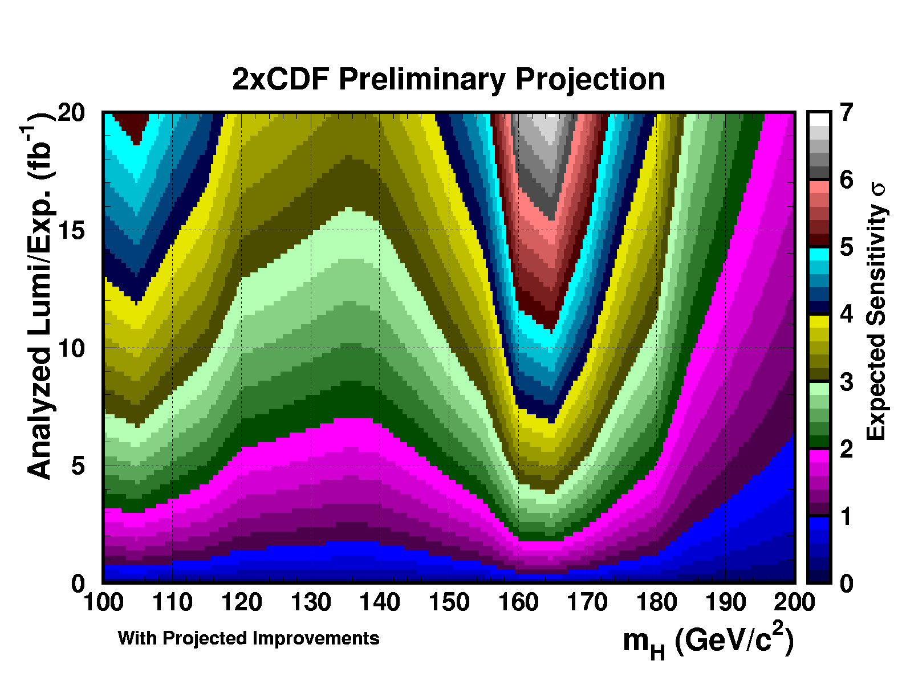
Tevatron Prospect for Finding Higgs

Slide 36
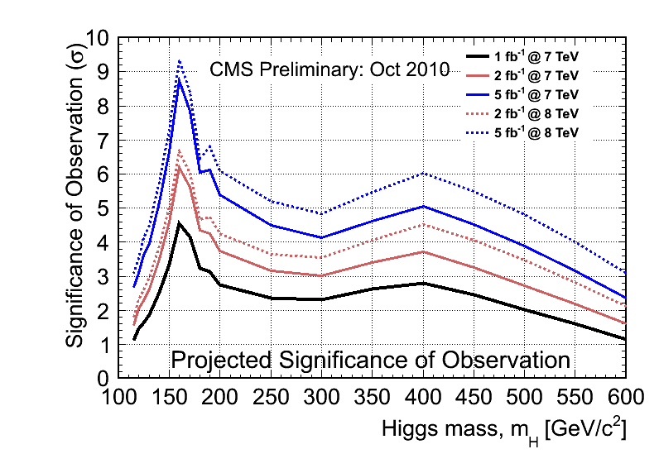
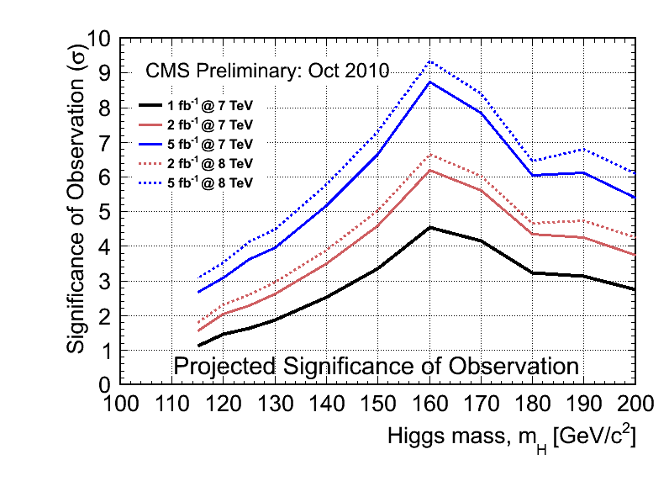
Prospects at the LHC

Slide 37
What If the Higgs Is Not Found?
We’re after the mechanism behind electroweak symmetry breaking (EWSB)
There are multiple ways to get EWSB
Standard Higgs mechanism is the easiest (from present perspective) way to get EWSB
Maybe nature took a different path
Possibilities: non-standard Higgs, supersymmetry, technicolor, littlest Higgs
Failing to find the Higgs boson is exciting (for particle physicists).

Slide 38
What About the Mass of the Proton
It is incorrect to claim that the Higgs Boson explains the mass in the universe
Proton mass is 2% from quarks (constituents) and 98% from dynamics!
And atoms account for only a few percent of the mass in the universe.

Slide 39
Summary
This is an exciting time in particle physics
The Higgs boson is likely to be found or ruled out in a few years.
Finding the Higgs boson will complete the model developed in the 1960’s
fundamental source of mass
more work to resolve inconsistencies in the model
Ruling out the standard Higgs boson will motivate work to understand EWSB
something must happen because inconsistencies still exist

Slide 40
Blank

Slide 41
More Evidence that the Model Works

Slide 42
The LHC Accelerator
Lake Geneva
CMS experiment hall (P5)
Geneva Airport
LHC ring
SPS ring
Main CERN site

Slide 43
The CMS Apparatus

Slide 44
Why is the Higgs Hard to Find?
1983
The rate of producing the Higgs is smaller than rates for other processes.
SppS 1982
Tevatron I 1984
LEP 1990
Tevatron II 2001
LHC (7TeV) 2009
2005
1995
2007
1997
1995
2009

Slide 45
Last Year’s Results on the Higgs Search

