Slide 1
Muon Speed/Lifetime Study
Conducted by:
Adrian Lorenzana
David Harris

Slide 2
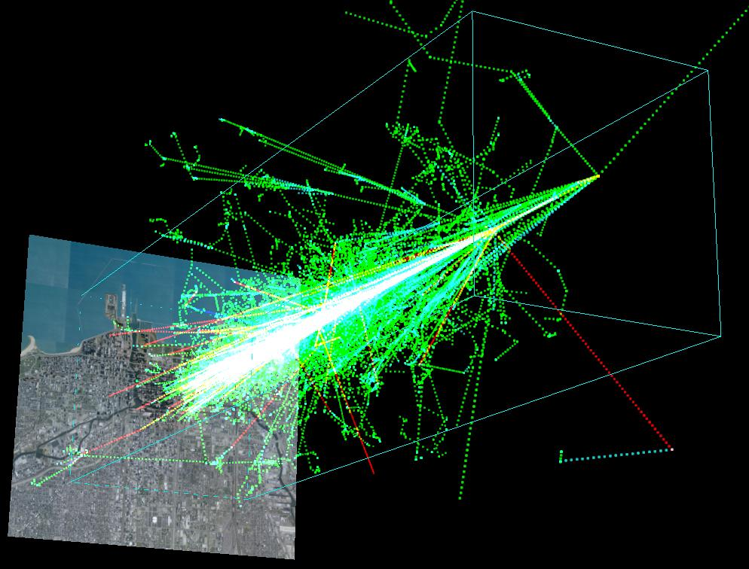
Introduction
Tasked to study Cosmic Rays
Cosmic Rays are charged particles that collide with matter in the atmosphere and send down a shower of smaller subatomic particles, some of which are muons
Set out to verify previous calculations of Muon speed and rate of decay as a way of witnessing relativity and time dilation

Slide 3
Lifetime Procedure
Stacked four detectors vertically with about .25m space in between
Collect lots of data on single fold coincidence
Analyze the data using e-Lab for muons that decayed within the detector, program generates a graph

Slide 4
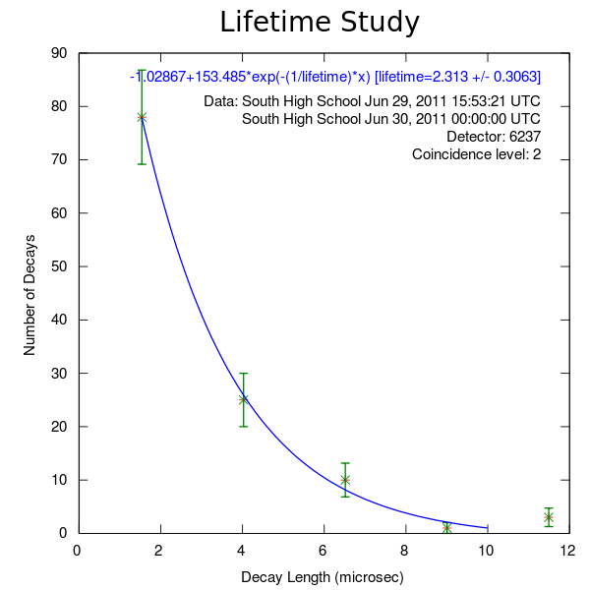

Slide 5
Lifetime Study Results
Found a lifetime of 2.3 microseconds, with an error of ±0.3 microseconds
Very close to the accepted muon lifetime of 2.2 microseconds
So far, the study submitted to e-Lab with the best results, and possibly the only one with correct results

Slide 6
Muon Speed Study Procedure
Spaced four detectors identically to the lifetime study, in a stacked formation
Set detector to record all events with four-fold coincidence to best ensure a muon event
Analyzed data with Excel to find the time the muon triggered the first and fourth detector
Find rate using distance over time

Slide 7
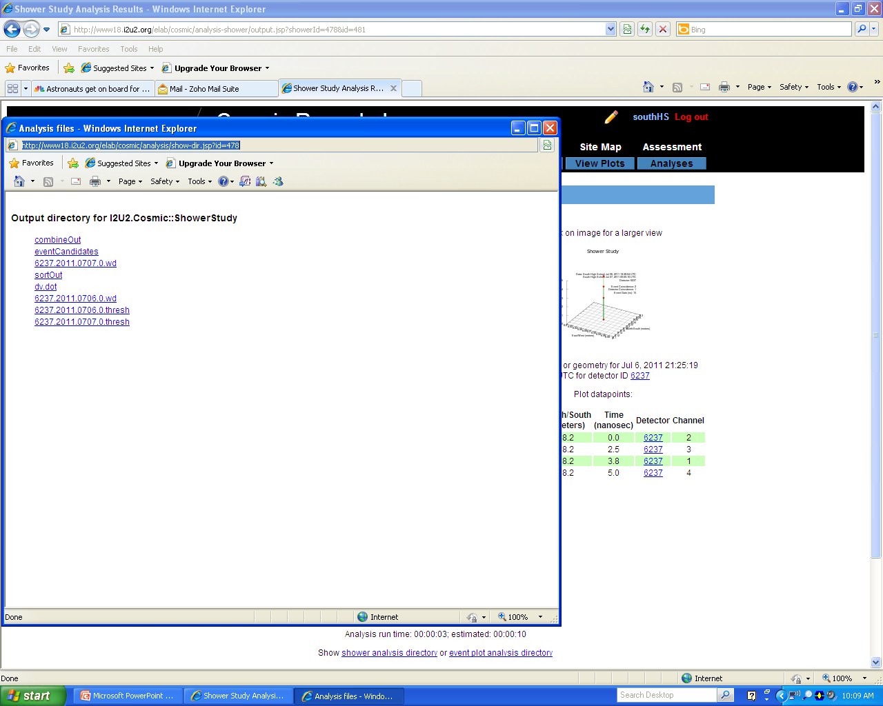
Muon Speed Data Analysis
Using e-Lab, we ran a shower study on the data, which generated a text file

Slide 8
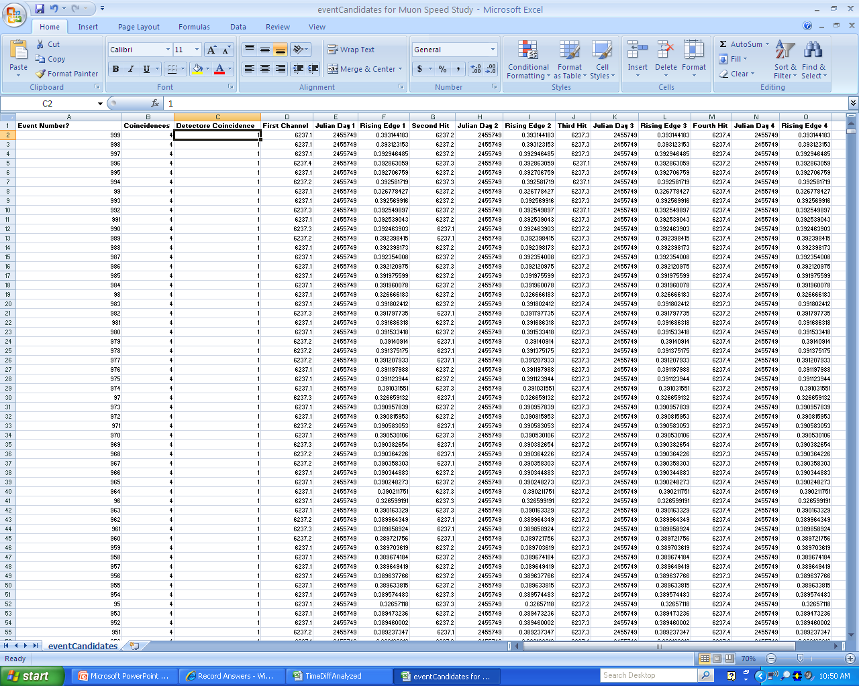
Muon Speed Data Analysis

Slide 9
Muon Speed Data Analysis

Slide 10
Muon Speed Study Results
We found an average speed of 154268417.1 meters per second, about 51.4% the speed of light, mode of 122666666.7, about 40.9% speed of light
A muon traveling that speed cannot make the journey from space to detector, as it would decay before arrival.
The muon would decay after 2.56 microseconds (when traveling at the highest speed we found, 154268417.1 m/s, compared to the original 2.197).

Slide 11
Muon Speed Study Results cont.
Muon traveling at this speed from 15 kilometers above the earth would only make it 395.12 meters
Conceivable that the muon traveled at near light speed until reaching the building, then slowed down when it passed through matter
Results are actually consistent with other studies posted on e-Lab

Slide 12
Muon Speed Further Discussion
To verify our source of error, an experiment detecting muons outdoors would have to be run

